Slide 1
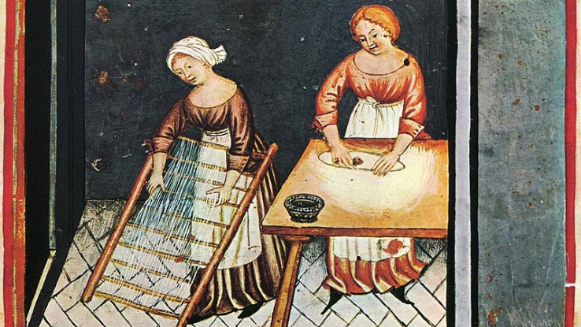
Frameworks of Women’s History: Theory and Methodology

Slide 2
Overview
Periodization
Sources
Perspective

Slide 3
Periodization
Ancient (500 B.C.E. to 400 C.E.)
Medieval (400 C.E. to 1500 C.E.)
Early Modern (1500 C.E. to 1789 C.E.)
Modern (1789- now)
European History

Slide 4
History as a story of progress?

Slide 5
Medieval
Renaissance
Enlightenment
But did these historical events benefit women?
Did women’s lives IMPROVE?
INVERSE AND OPPOSITE EFFECT ON WOMEN

Slide 6
Women’s History as Cyclical

Slide 7
Continuity and Change
Continuity of ideas from ancient Greece and Rome
Changes: Urbanization, social organization, socio-cultural

Slide 8
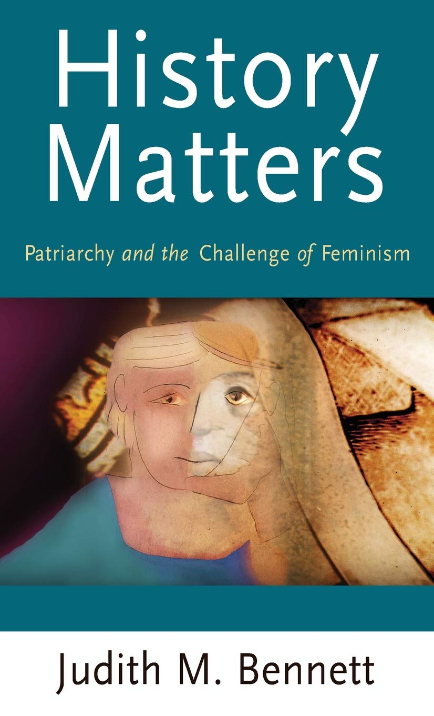
Patriarchal Equilibrium

Slide 9
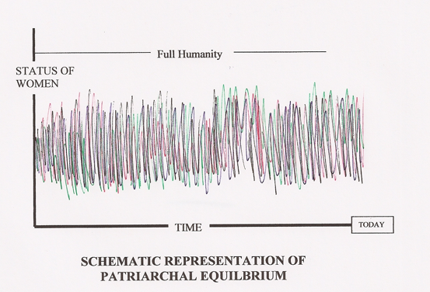

Slide 10
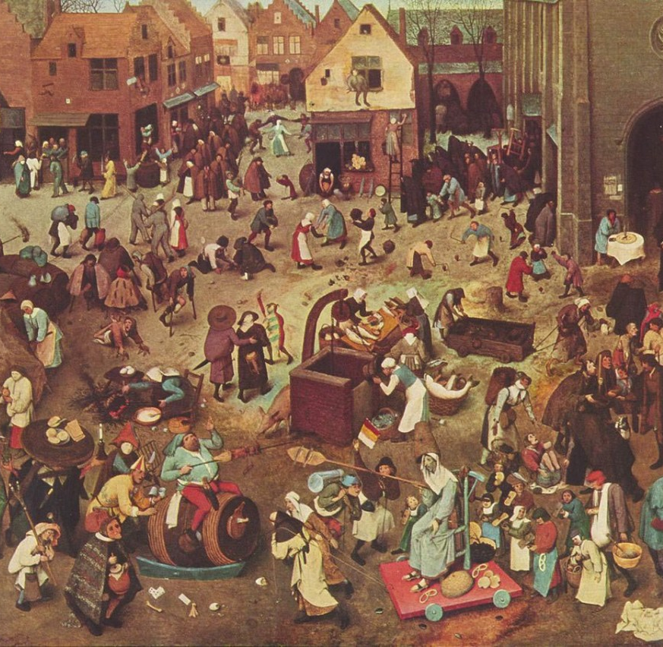
The Dark Ages?

Slide 11
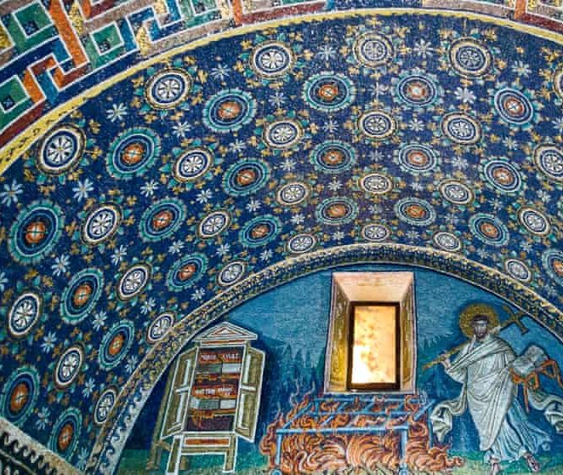
The Bright Ages

Slide 12
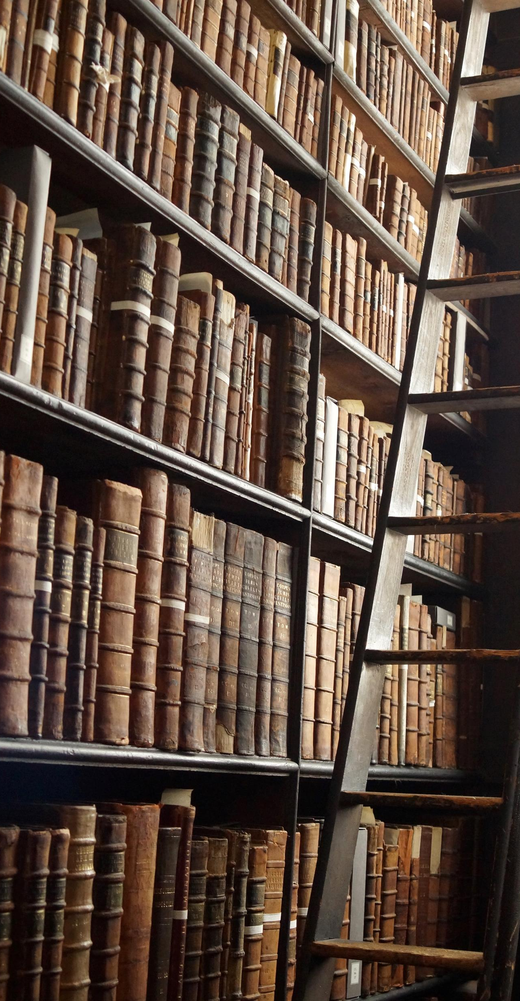
Historical Sources

Slide 13
How are sources for women’s history different?
Fewer sources written by women
Theory versus practice (prescriptive versus descriptive)

Slide 14
PERSPECTIVE

Slide 15
Before 1950
1960s/1970s
1980s
1990s
Chronology of Women’s History
Very few scholars
Eileen Power
Feminist movement
“women worthies”
E.g. Joan of Arc or Eleanor of Aquitaine
Emphasis on oppression and subordination
Agency
“Gender: A useful category of historical analysis” (Joan Scott)

Slide 16
Women’s AND Gender History
”Gender is a constitutive element of social relationships based on perceived differences between the sexes and gender is a primary way of signifying relationships of power.” (Joan Scott)

Slide 17
Patriarchy
Power and authority held by men
All women and some men subordinated

Slide 18
Patriarchal System
All women perceived as mentally, physically, and morally weaker than men
BUT
Importance of intersectionality
consideration of race, class, gender, religion, ability, sexual orientation

