Slide 1
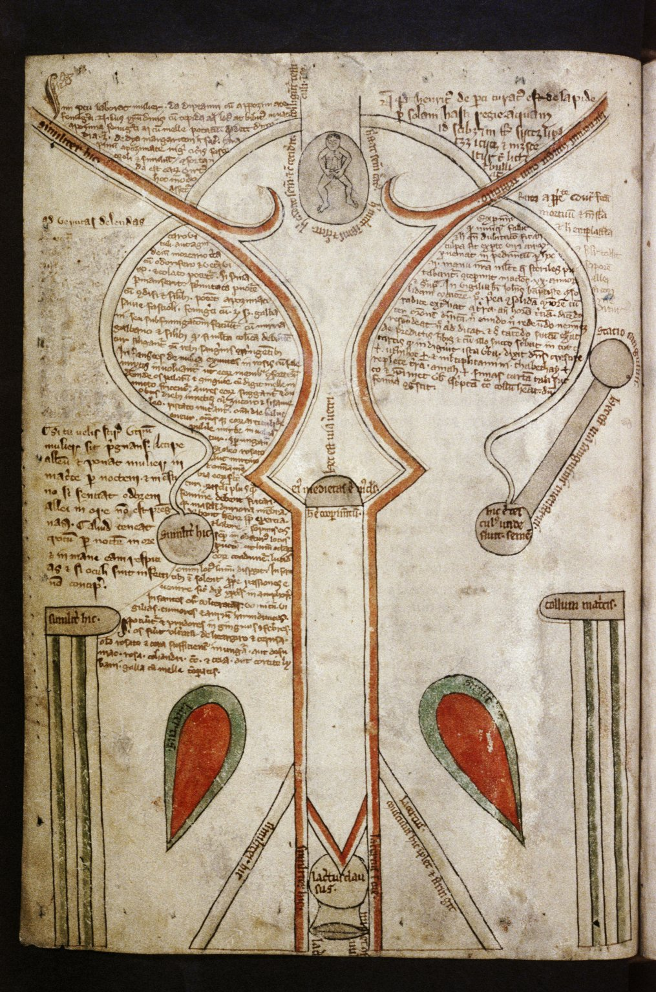
FRAMEWORKS: PHILOSOPHY AND MEDICINE

Slide 2
Medieval Gender Ideology
Jewish religious traditions
Christian religious traditions
Ancient Greek and Roman medical and philosophical treatises
Medieval theologians attempting to reconcile the two

Slide 3
How ancient Greek and Roman ideas emphasized women's mental and physical weakness (Hippocrates, Galen, and Aristotle)
How these ideas about women's bodies were then absorbed and interpreted in the medieval period (Hildegard of Bingen and Thomas Aquinas)
TODAY'S FOCUS

Slide 4
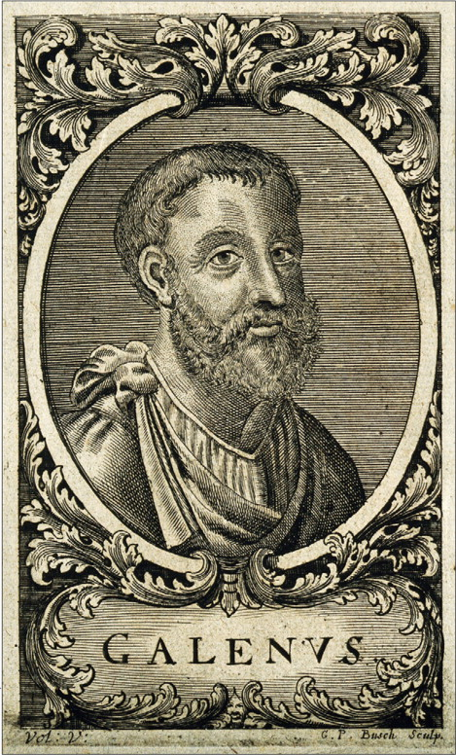
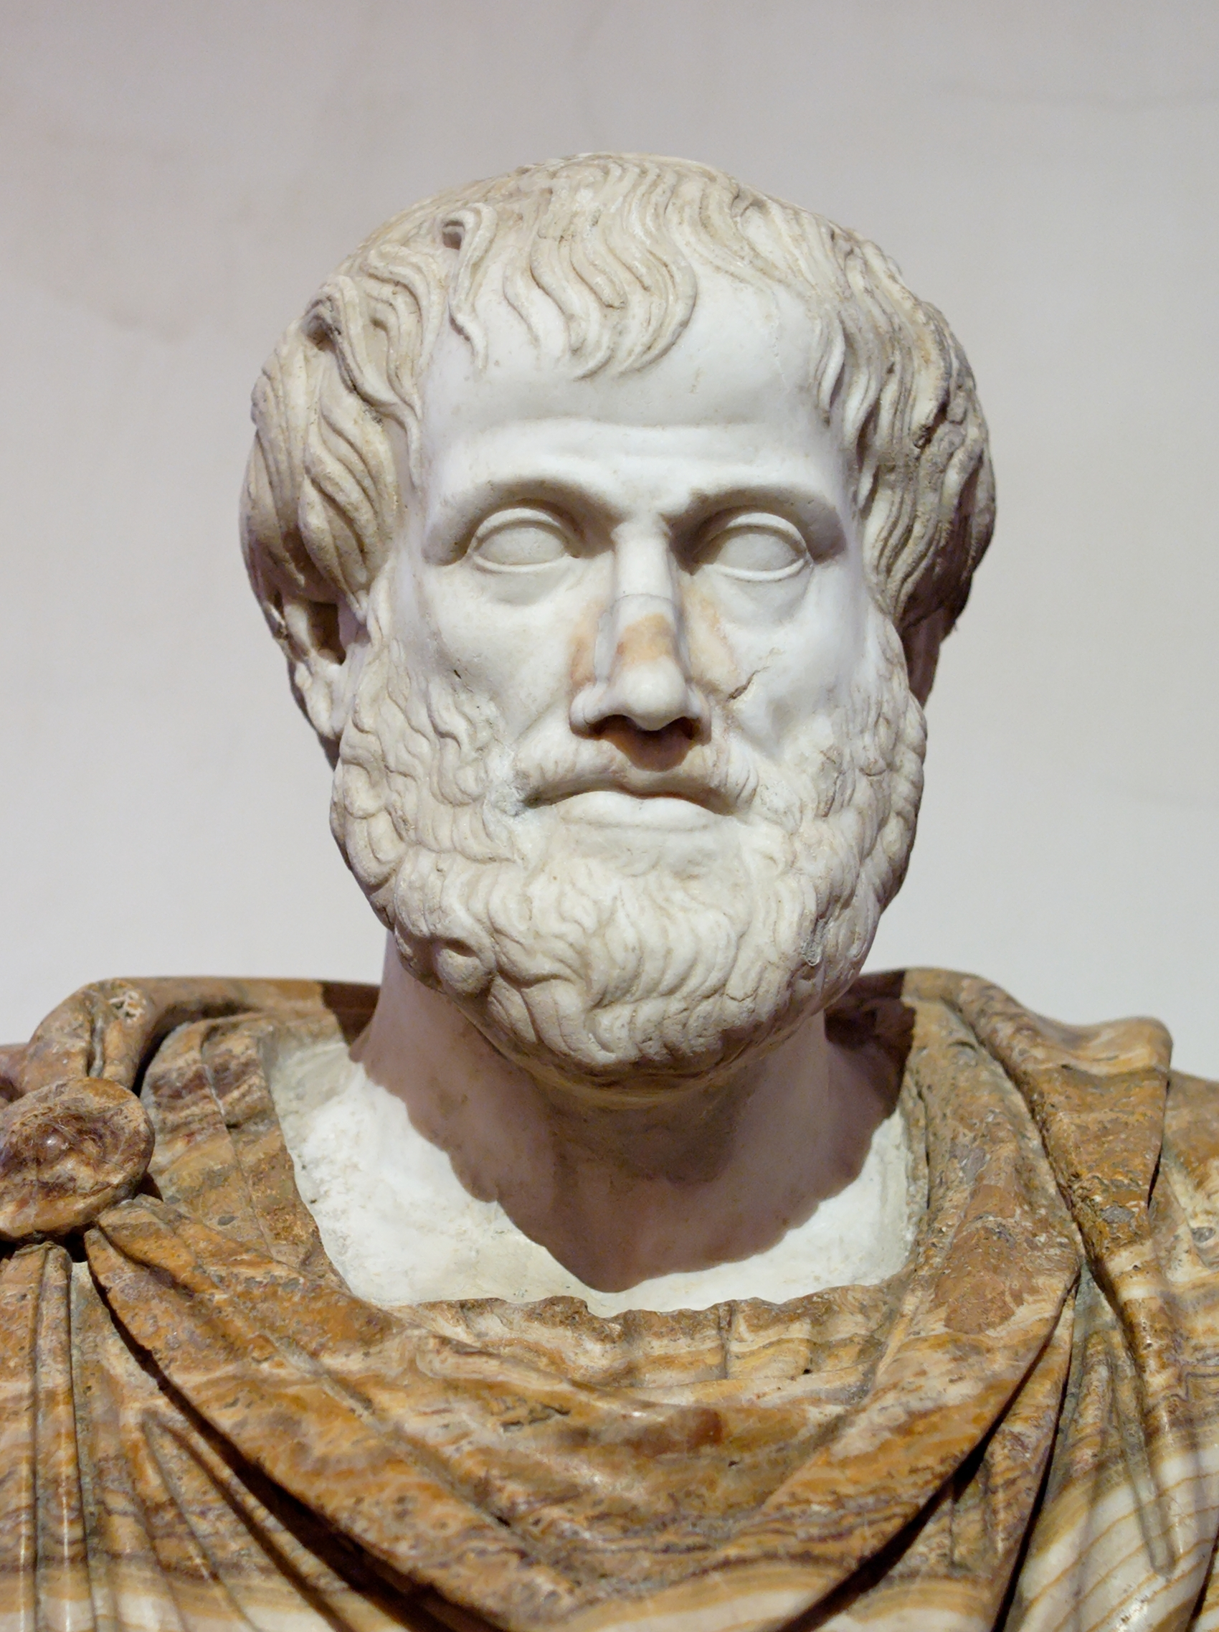
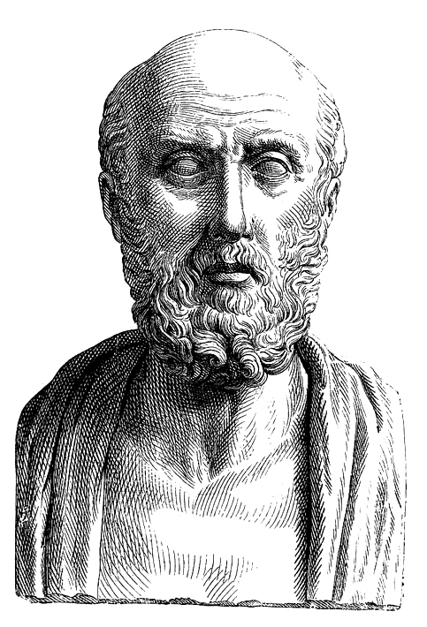
Galen, 129-216 C.E.
Aristotle, 384-322 B.C.E.
Hippocrates, 460-370 B.C.E.

Slide 5
HIPPOCRATES, 460-370 B.C.E.

Slide 6
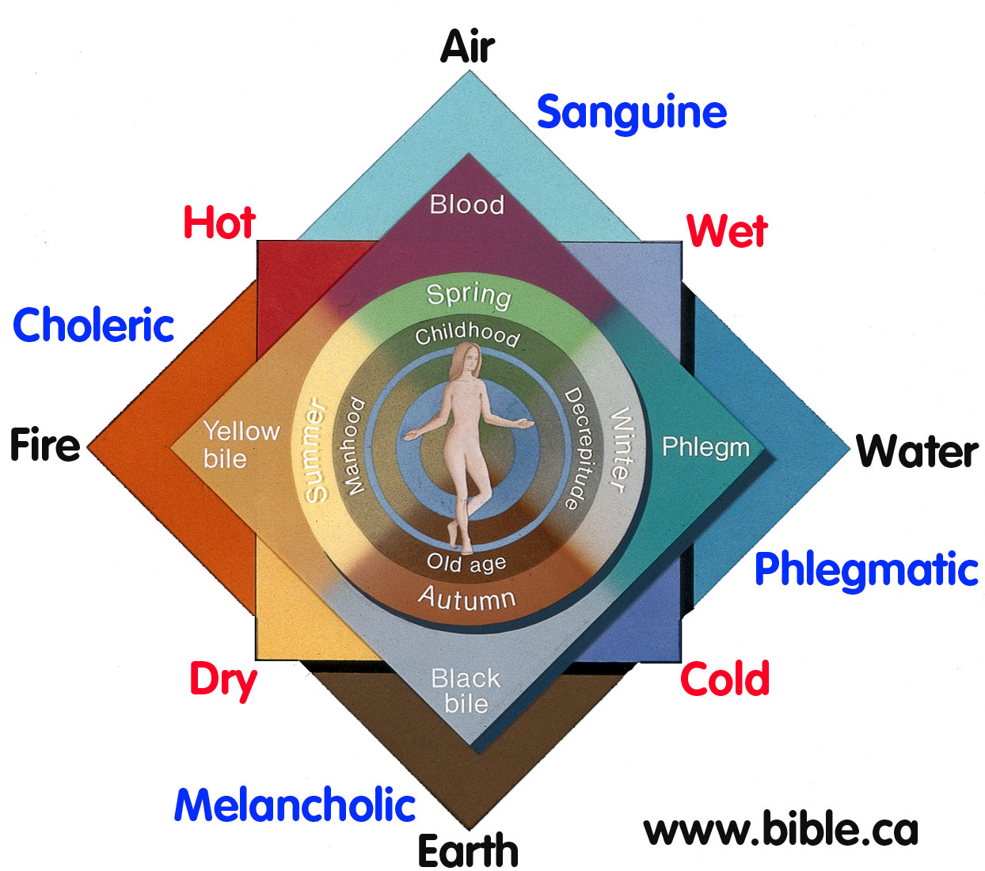
Humoral Theory

Slide 7
Hippocrates "On Virgins" and "Diseases of Women"
Menstruation
Sexual Activity
Wandering Womb

Slide 8
ARISTOTLE, 384-322 B.C.E.

Slide 9
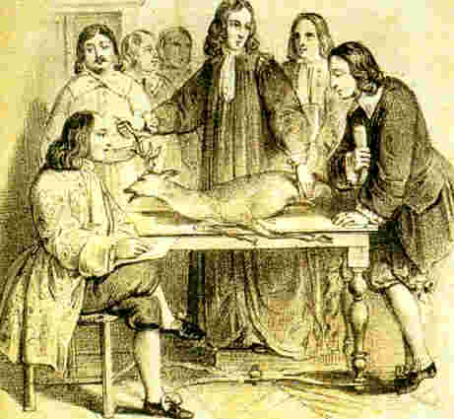
William Harvey discovers eggs in female deer (17th century)
Eggs in female humans discovered in 1827

Slide 10
Aristotelean Binaries
Hot
Dry
Able
Active
Rational
Cold
Wet
Disabled
Passive
Irrational
MALE
FEMALE

Slide 11
On the Generation of Animals
“Now the weaker creature too must out of necessity produce a residue, greater in amount and less thoroughly concocted; and this, if such is its character, must of necessity be a volume of bloodlike fluid. (iii) That which by nature has a smaller share of heat is weaker; and the female answers to that description…”

Slide 12
On the Generation of Animals
"Now it is impossible that any creature should produce two seminal secretions at once, and as the secretion in females which answers to semen in males is the menstrual fluid, it obviously follows that the female does not contribute any semen to generation; for if there were semen, there would be no menstrual fluid; but as menstrual fluid is in fact formed, therefore there is no semen…"

Slide 13
On the Generation of Animals
"By now it is plain that the contribution which the female makes to generation is the matter used therein, that this is to be found in the substance constituting the menstrual fluid, and finally that the menstrual fluid is a residue…A women is as it were an infertile male; the female, in fact, is female on account of inability of a sort…it lacks the power to concoct semen out of the final state of nourishment…because of the coldness of its nature…”

Slide 14
On the Generation of Animals
"The male provides the “form” and the “principle of the movement”, the female provides the body, in other words, the material. Compare the coagulation of milk. Here, the milk is the body, and the fig-juice or the rennet contains the principle which causes it to set.”

Slide 15
"When the semen has entered the uterus it ‘sets’ the residue produced by the female and imparts to it the same movement with which it is itself endowed. The female’s contribution, of course, is a residue too…and contains all the parts of the body potentially, though none in actuality; and ‘all’ includes those parts which distinguish the two sections.
Just as it sometimes happens that deformed offspring are produced by deformed parents, and sometimes not, so the offspring produced by a female are sometimes female, sometimes not, but male. The reason is that the female is as it were a deformed male; and the menstrual discharge is semen, though in an impure condition; i.e. it lacks one constituent, and one only, the principle of Soul."
On the Generation of Animals

Slide 16
On the Generation of Animals
"An animal is a living body, a body with Soul in it. The female always provides the material, the male provides that which fashions the material into shape; this, in our view, is the specific characteristic of each of the sexes: that is what it means to be male or female…"

Slide 17
On the Generation of Animals
"Once the birth has taken place everything reaches its perfection sooner in females than in males—because females are weaker and colder in their nature; and we should look upon the female state as being as it were a deformity, though one which occurs in the ordinary course of nature."

Slide 18
Aristotle on Women: Overview
Colder and wetter
Passive role in reproduction
Provide recepticle and matter
Nourish fetus with menstrual blood
Did not contribute to form, intellect, spirit
Females result of something going wrong in conception

Slide 19
GALEN, 129-216 C.E.

Slide 20
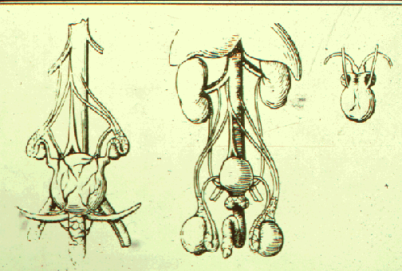
Galen: Humoral Theory and the One-Sex Model
Andreas Vesalius, 16th century

Slide 21
“This is the reason why the female was made cold, and the immediate consequence of this is the imperfection of the parts which cannot emerge on the outside on account of the defect in the heat…For, remaining within, that which would have become the scrotum if it had emerged on the outside was made into the substance of the uteri, an instrument fitted to receive and retain the semen and to nourish and perfect the foetus.”
“forthwith, of course, the female must have smaller and less perfect testes and the semen generated in them must be scantier, colder, and wetter…Certainly such semen would be incapable of generating an animal…”
Galen

Slide 22
IMPLICATIONS???

Slide 23
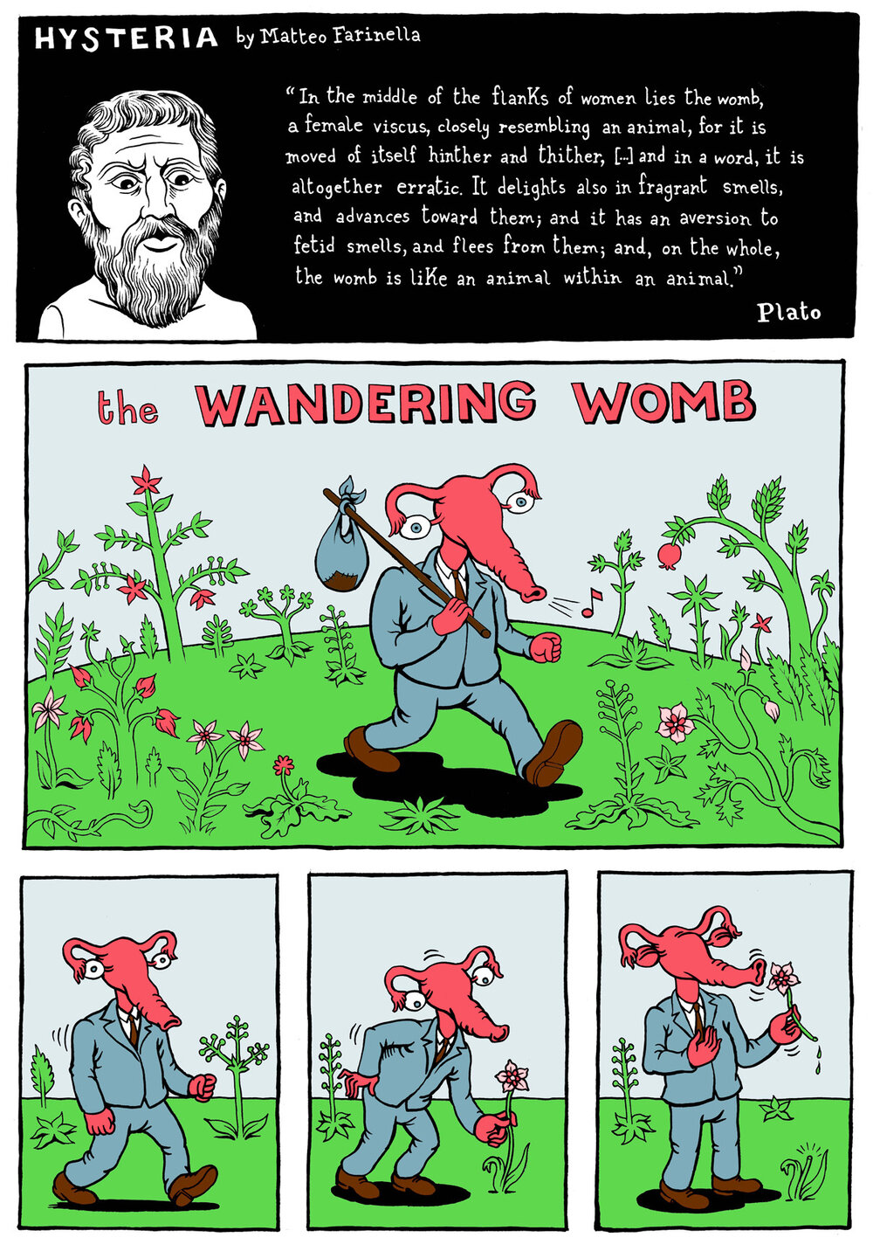
Matteo Farinella

Slide 24
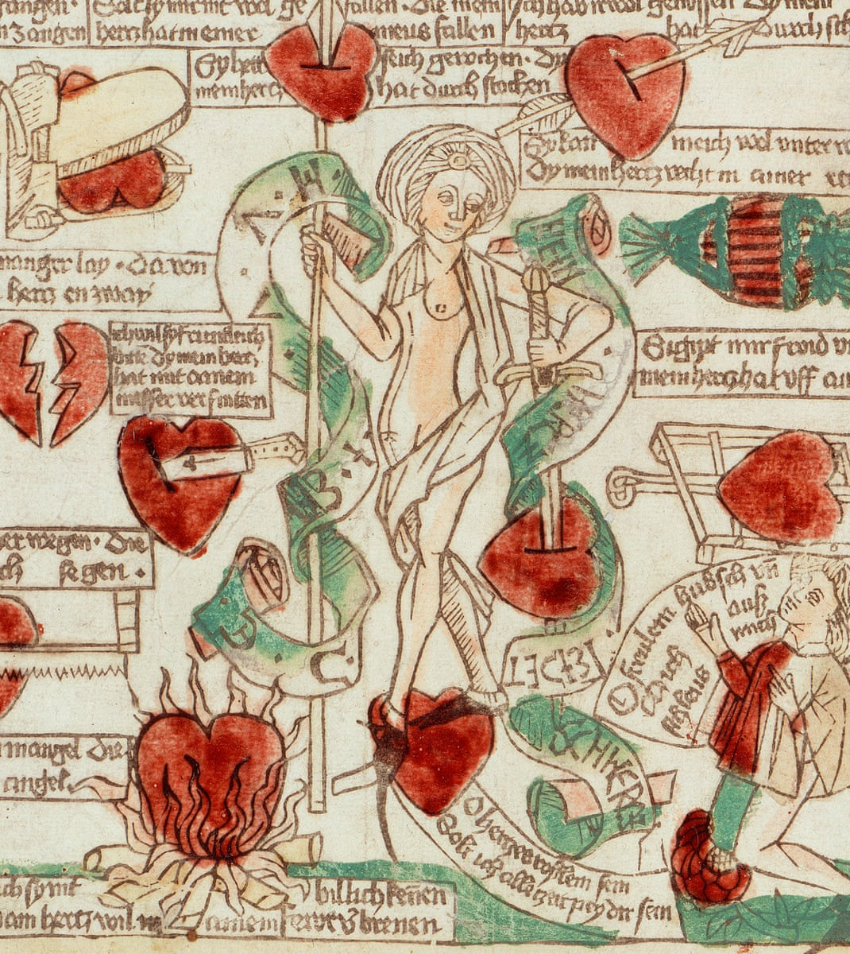
MEDIEVAL SYNTHESIS
Image: Venus und der Verliebte, Meister Casper (1485)

Slide 25
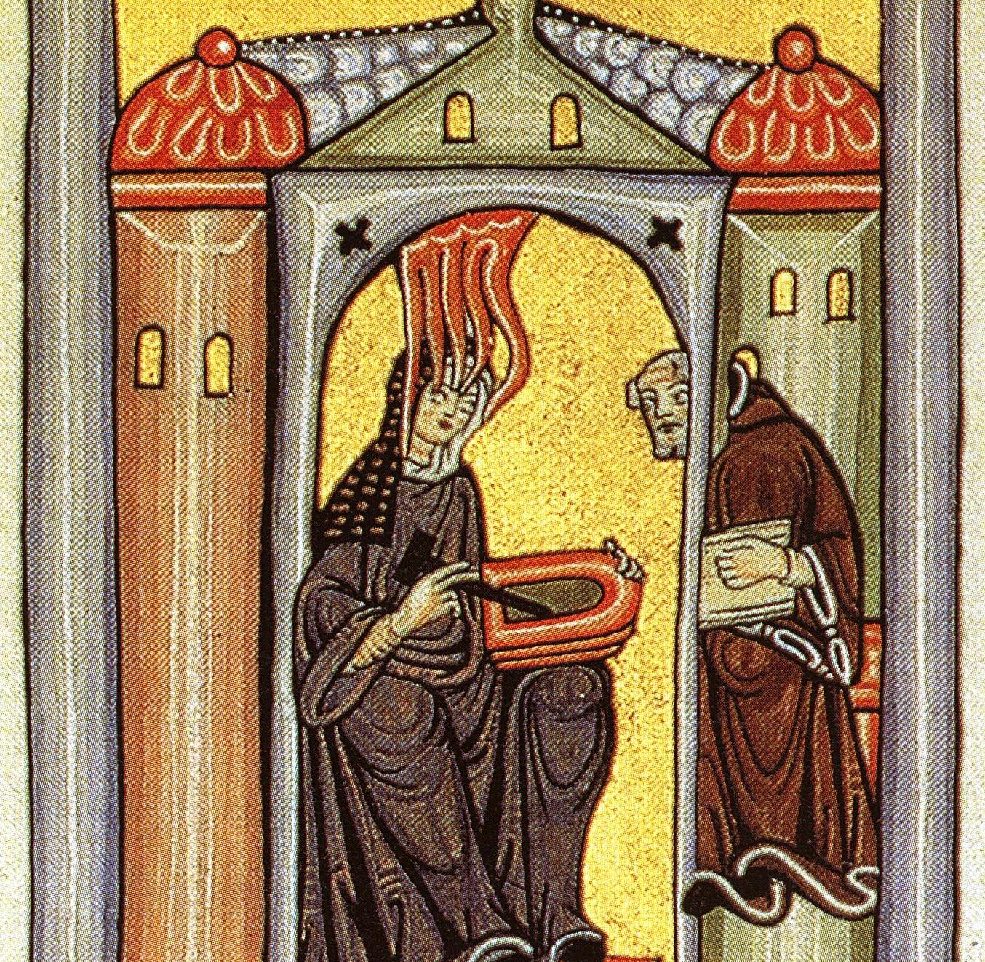
Hildegard of Bingen, 1098-1179

Slide 26
Hildegard's medical ideas
Human conception and Creation Story
Adam = clay and water = fiery spirit/strong and hard
Eve = flesh and marrow = softer and weaker
Men = fortis (strong)
Women = Mollis (soft)

Slide 27
Thomas Aquinas,
1225-1274
Summa Theologiae

Slide 28
Question 91: The Production of First Man's Body
Question 92: The Production of Woman
1. Whether the woman should have been made in the first production of things?
2. Whether woman should have been made for man?
3. Whether of man's rib?
4. Whether the woman was made immediately by God?
1. Whether the body of the first man was made of the slime of the earth?
2. Whether the human body was immediately produced by God?
3. Whether the body of man was given an apt disposition?
4. Whether the production of the human body is fittingly described in Scripture?

Slide 29
What is the overall perception of women's bodies?

