Slide 1
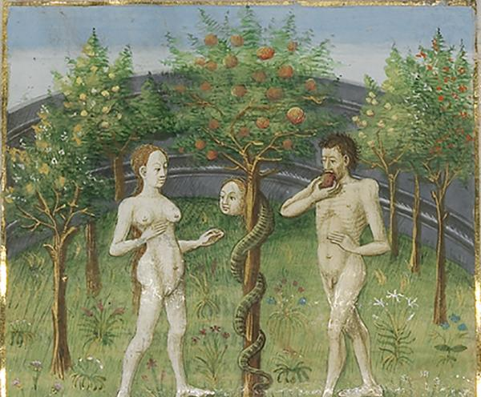
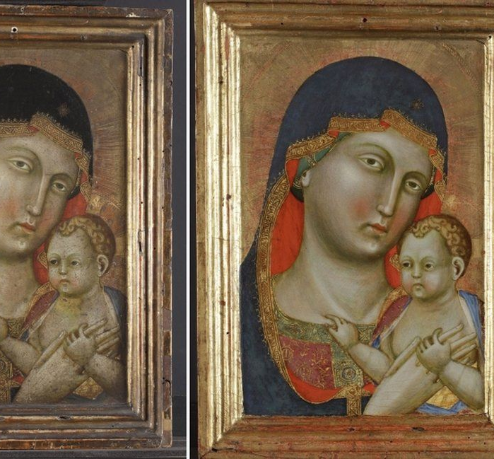
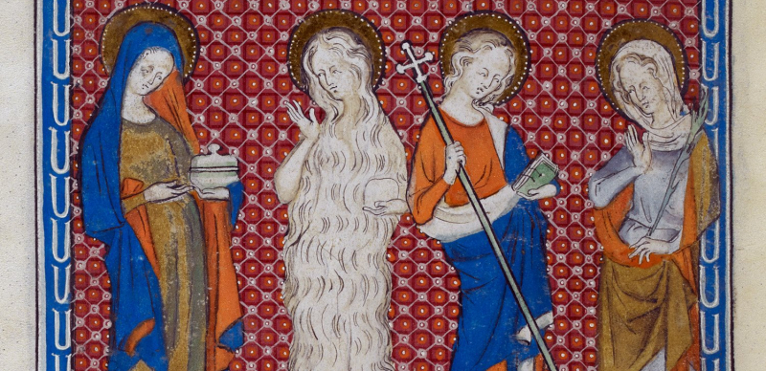
Frameworks: Christianity

Slide 2
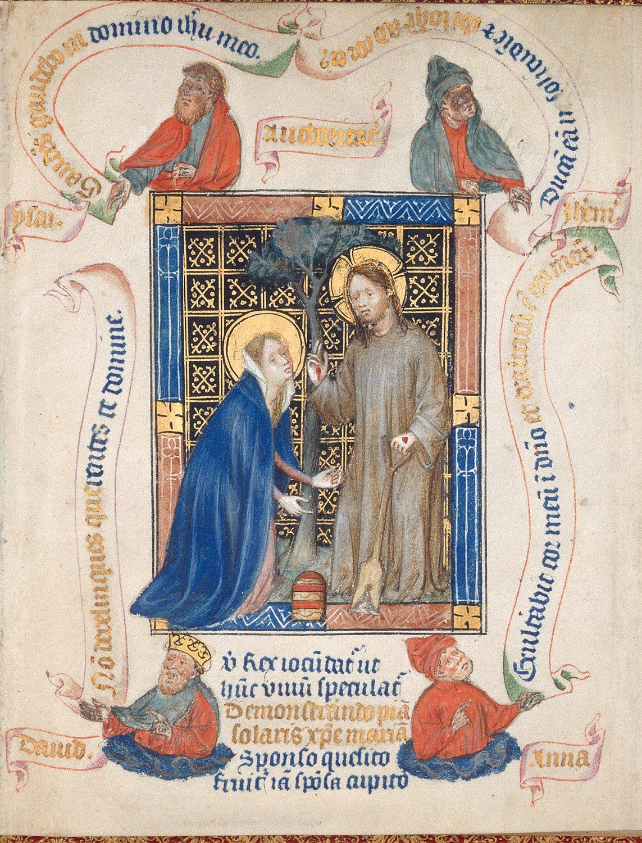
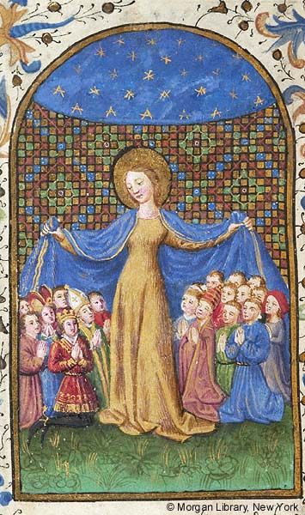
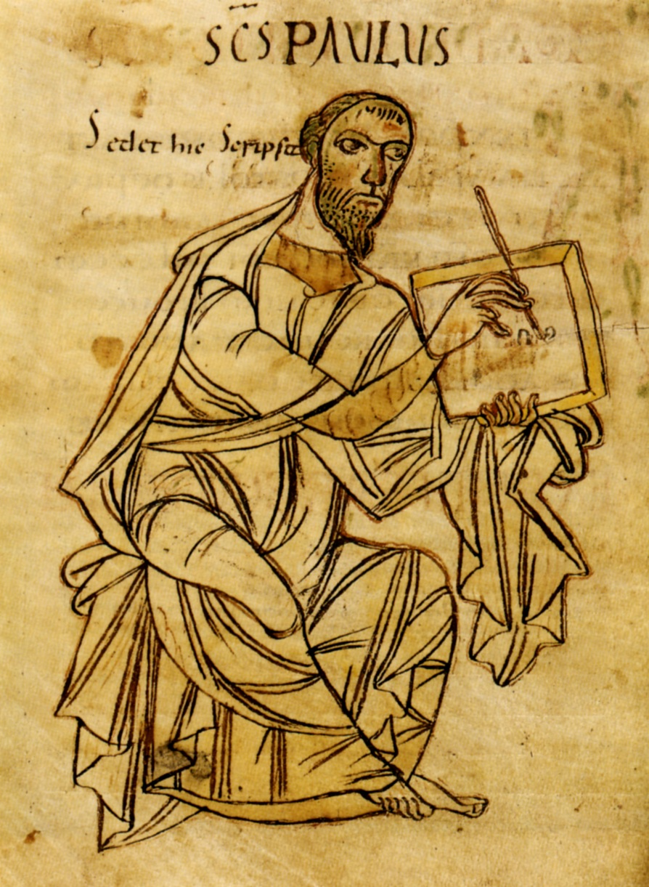
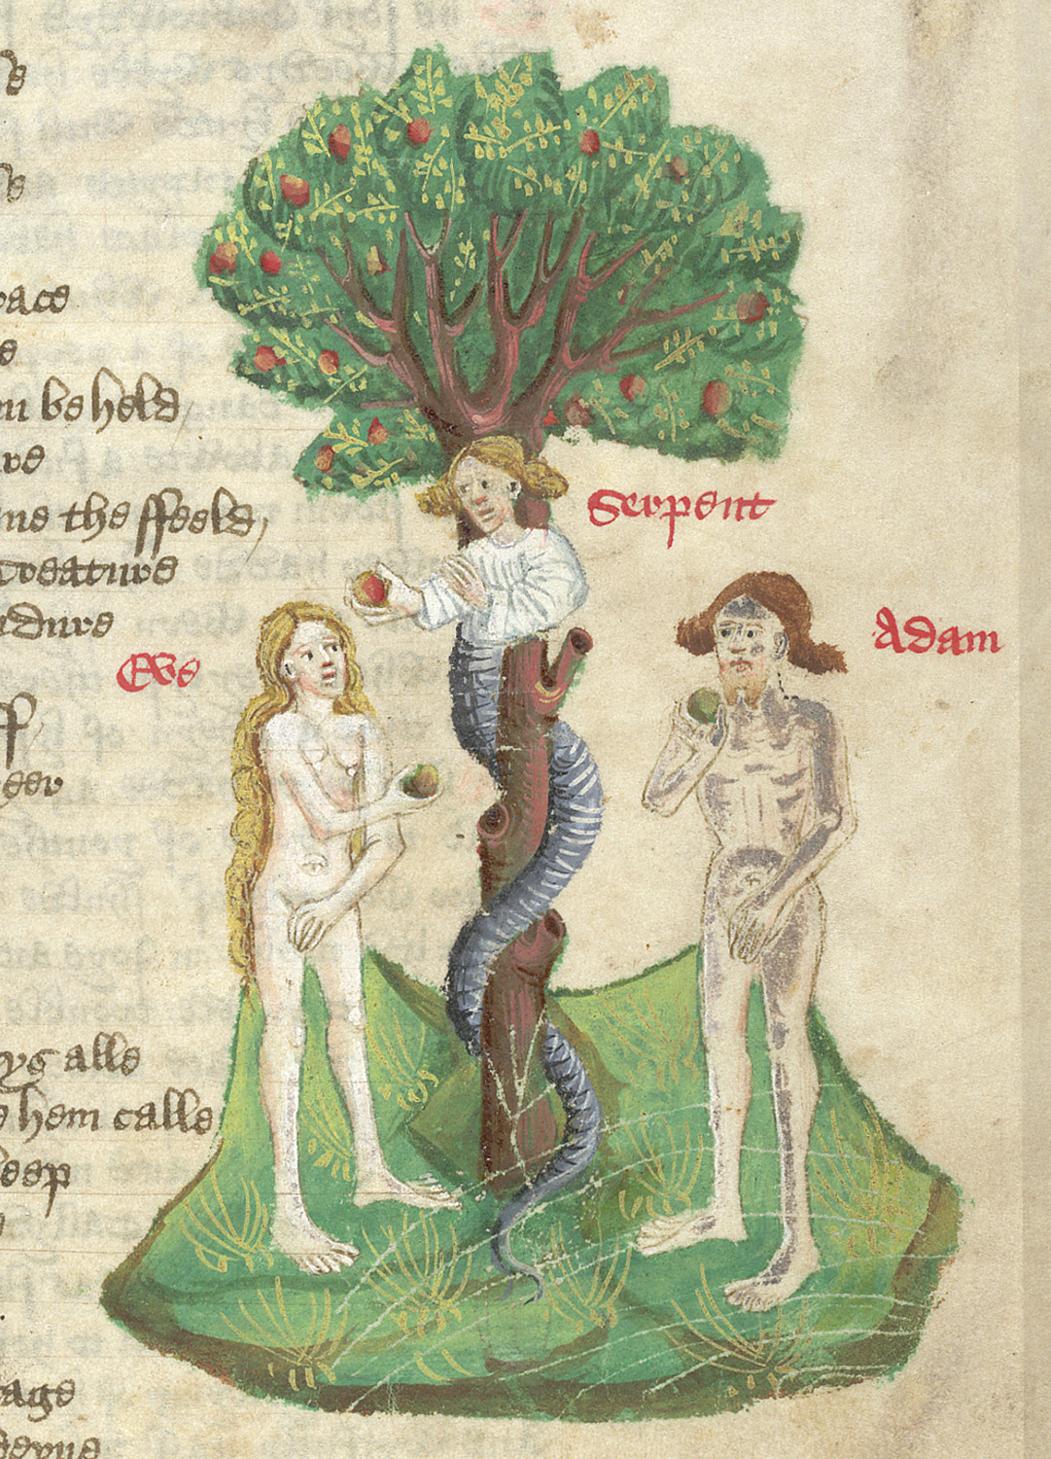
Mary Magdalene
Virgin Mary
Paul of Tarsus
Eve

Slide 3
Eve

Slide 4
Eve... as a seeker of knowledge
"So when the woman saw that the tree was good for food...and that the tree was to be desired to make one wise, she took of its fruit and ate." Genesis 3:6

Slide 5
Adam and Eve: Harmonious Relationship?
Two Creation Stories:
"So God created man in his own image, in the image of God he created him; male and female he created them."
"and the rib which the Lord God had taken from the man he made into a woman and brought her to the man."

Slide 6
Lilith...Adam's first wife?
Medieval Judaism (700-1000 C.E.)
Quarreled with Adam
Baby-killing demon

Slide 7
Eve and Bodily punishments
Body as site of punishment for transgression
Ate apple from tree of knowledge BUT convinced Adam to do so
“You are the Devil’s gateway. You are the first deserter of the divine law... You destroyed so easily God’s image, man. On account of your desert, that is death, even the Son of God had to die”. (Tertullian, 2nd century)

Slide 8
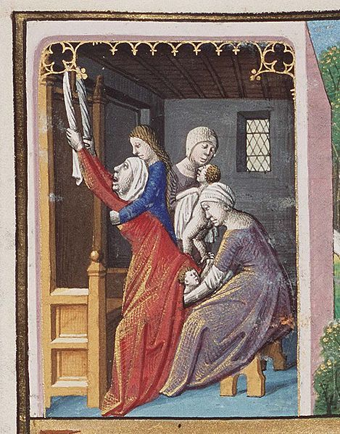
"Birth of Jacob and Esau" from 1475-80

Slide 9
Eve's Legacy
As a Temptress
As a Chatterbox
Used as justification for women's subservience

Slide 10
Mary Magdalene
Repentant sinner
Believer
Witness to resurrection
Apostola apostolorum = "apostle of the apostles"

Slide 11
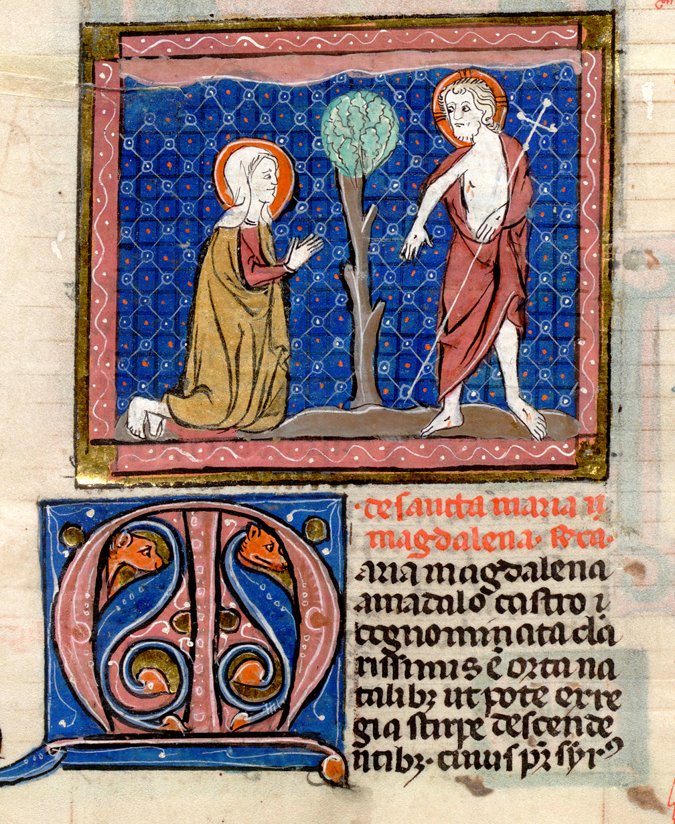
Mary Magdalene in the Bible
Repentant sinner forgiven by Jesus
Shares news of his resurrection

Slide 12
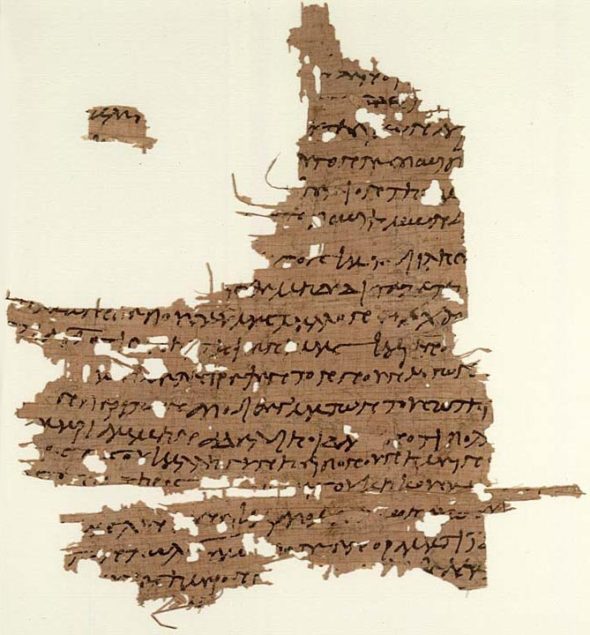
Mary Magdalene in the Gospel of Mary Magdala
Gnostic Gospels
Egypt
Know yourself = Know God
Equality of men and women
Women as priests

Slide 13
Chapter 5 “But they were grieved. They wept greatly saying: How shall we go to the Gentiles and preach the gospel of the Kingdom of the Son of Man? If they did not spare him, how will they spare us?
Then Mary stood up, greeted them all, and said to her brethren, Do not weep and do not grieve nor be irresolute, for his grace will be entirely with you and will protect you…
Peter said to Mary, Sister we know that the Saviour loved you more than the rest of woman.
Tell us the words of the Saviour which you remember which you know, but we do not, nor have we heard them”

Slide 14
Chapter 9 “When Mary had said this, she fell silent, since it was to this point that the Saviour had spoken with her.
But Andrew answered and said to the brethren, Say what you wish to say about what she has said. I at least do not believe that the Saviour said this…
Peter answered and spoke concerning the same things
He questioned them about the Saviour. Did He really speak privately with a woman and not openly to us? Are we to turn about and all listen to her? Did He prefer her to us?
Levi answered and said to Peter, Peter you have always been hot tempered.
Now I see you contenting against the woman like adversaries.
But if the Saviour made her worthy, who are you indeed to reject her? Surely the Saviour knows her very well.

Slide 15
Virgin Mary
Celebration starting in 12th century
Bernard of Clairvaux
Queen of Heaven
Mother to all

Slide 16
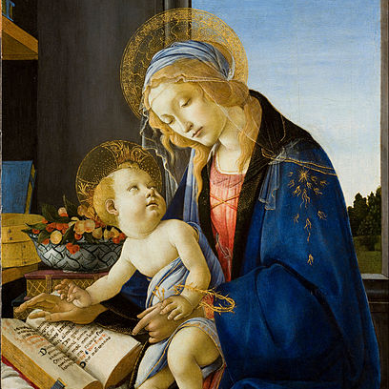
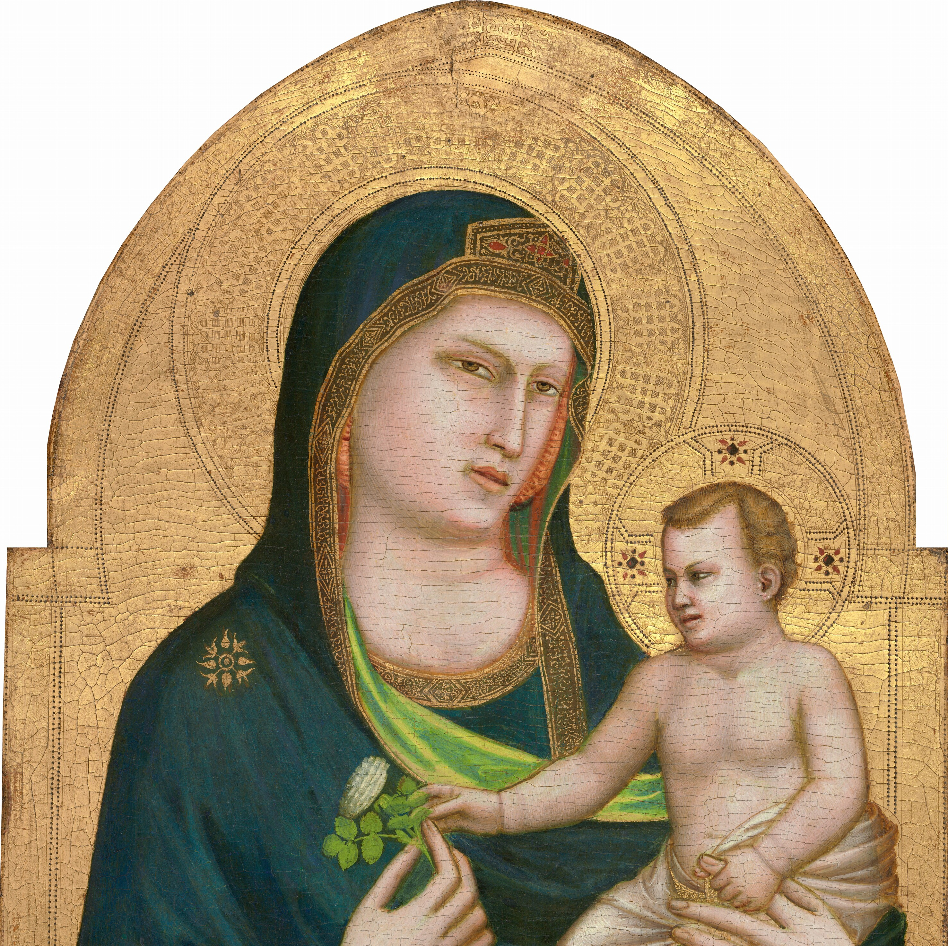
Botticelli, 1480
Giotto, 1310

Slide 17
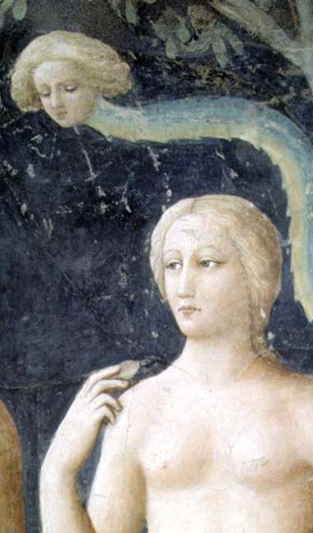
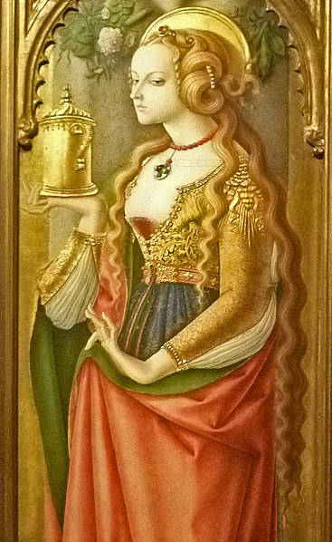

Slide 18
Paul of Tarsus
Lived 5-64 or 65 C.E.

Slide 19
“The husband should give to his wife her conjugal rights, and likewise the wife to her husband
For the wife does not have authority over her own body, but the husband does. Likewise the husband does not have authority over his own body, but the wife does.”
(1 Corinthians 7: 3-4)

Slide 20
“The head of every man is Christ, the head of a wife is her husband, and the head of Christ is God.”
(1 Corinthians 11:3)
“Wives, submit yourselves unto your own husbands, as unto the Lord.
For the husband is the head of the wife, even as Christ is the head of the church: and he is the saviour of the body.
Therefore as the church is subject unto Christ, so let wives be to their own husbands in everything.”
(Ephesians 5: 22-24)

Slide 21
“Let a woman learn quietly with all submissiveness.
I do not permit a woman to teach or exercise authority over a man; rather, she is to remain quiet.
For Adam was formed first, then Eve;
And Adam was not deceived, but the woman was deceived and became a transgressor.”
(1 Timothy 28: 11-14)

Slide 22
“For as many of you as were baptized into Christ have put on Christ. There is neither Jew nor Greek, there is neither slave nor free, there is neither male nor female; for you are all one in Christ Jesus.”
(Galatians 3:27)

Slide 23
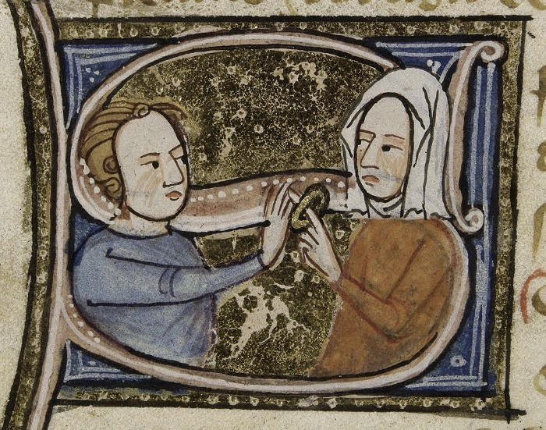
Patria potestas
God is the head of Christ
Christ is the head of man
Man is the head of woman

Slide 24
Ambivalent view of women
Interpreted in 4th-6th c.e. by Augustine and Jerome (and others all known as the "Church Fathers")
Souls worthy of salvation
"Equality of Souls but inequality of sexes"

Slide 25
Christian Doctrine
Ancient Greece/Rome
Eve and downfall of mankind
Temptress
Lack of trust
Ideal mother but unattainable
Repetent sinner
Equal souls before god
Not fully formed men
Defective
Abnormal
Cold/wet
Controlled by wombs
Cure illness by sex
Role in conception

