Slide 1
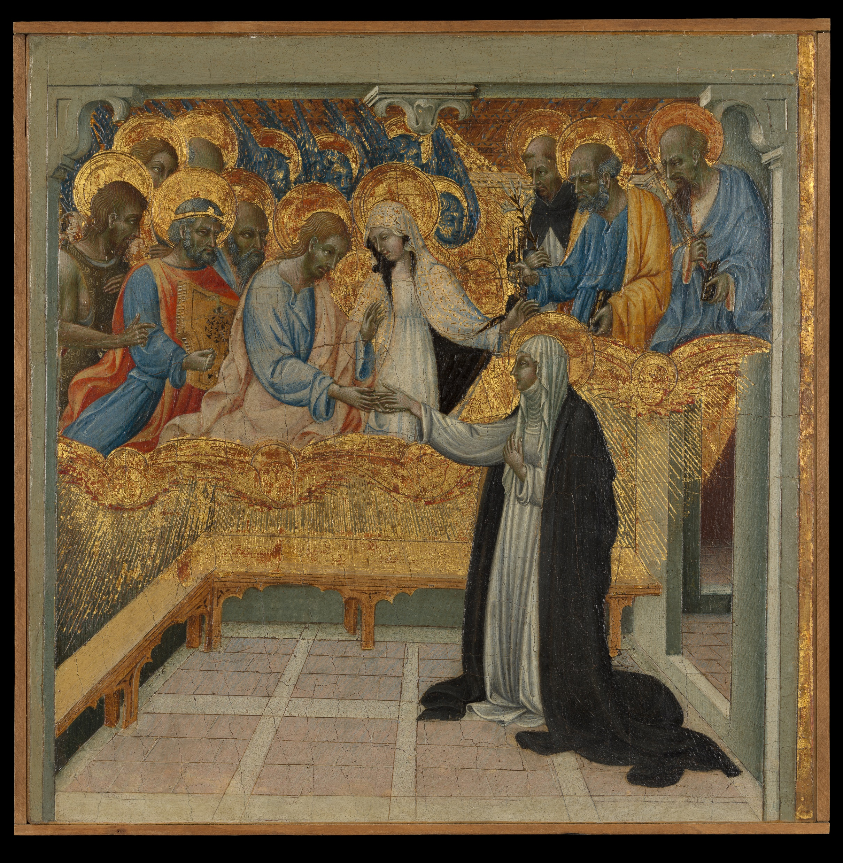
Christian Women’s Religious Experiences:
Catherine of Siena
and Margery Kempe
Image: “The Mystical Marriage of Catherine of Siena” by Giovanni di Paolo (1460)

Slide 2
Outline
Women and parish religion
Women as mystics
Catherine of Siena (1347-1390)
Margery Kempe (1373 to after 1438)
Women and Heresy
Catharism

Slide 3
Women and the Parish

Slide 4
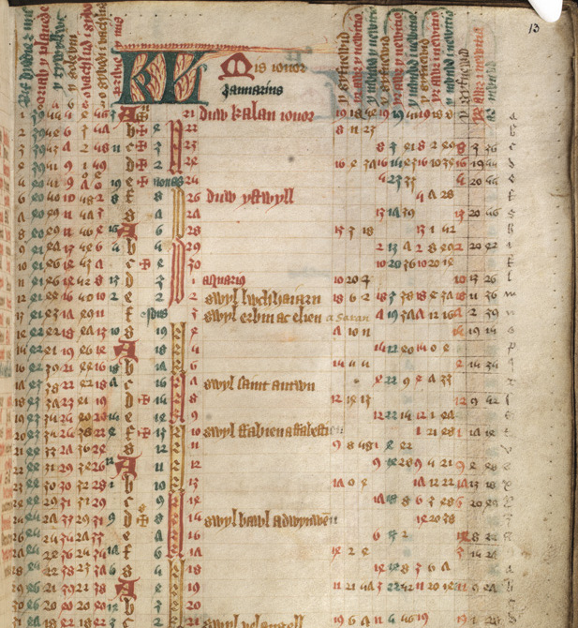
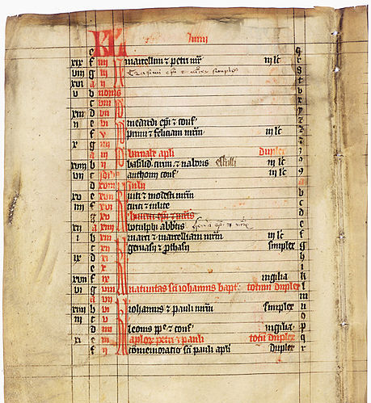
A Welsh Calendar of Feast Days (1488-98)
A Calendar of Feast Days from Finland (1340-1360)

Slide 5
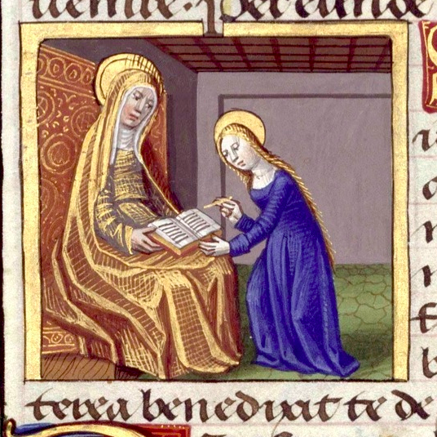
Religious processions
Attending Mass
Confraternities
Prayer to saints (e.g. St. Anne)
Pious donations
sacraments

Slide 6
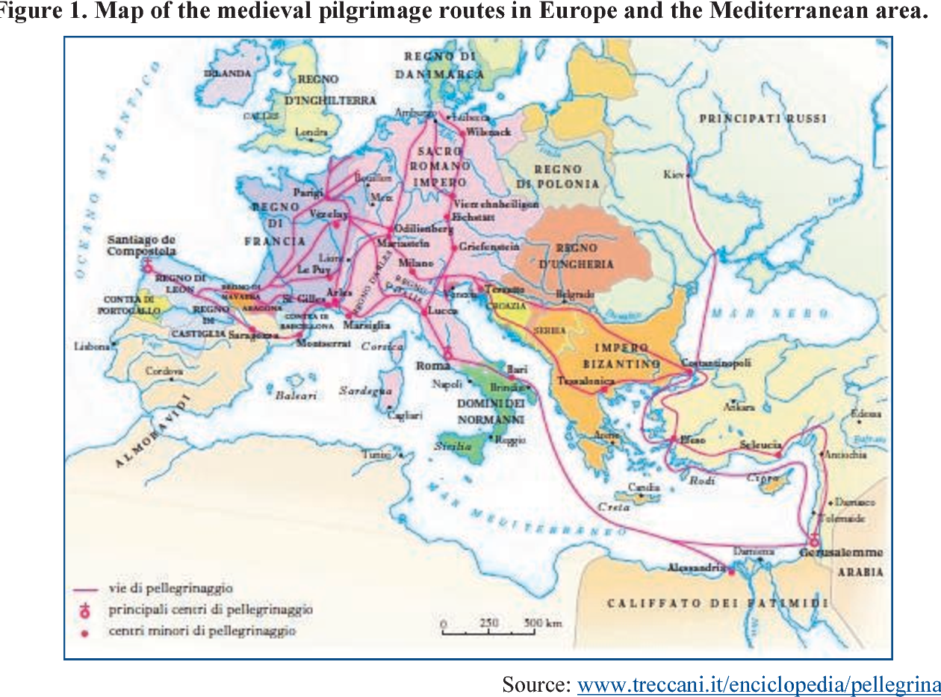

Slide 7
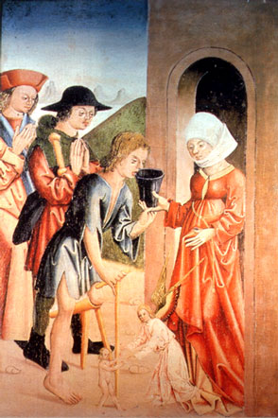
Beguines
Dame Agnes in “The Goodman of Paris”

Slide 8
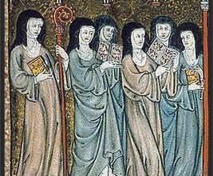
Nuns
Religious rule
Vows of poverty, chastity, obedience
Pope Boniface VIII (1294-1303) and enclosure

Slide 9
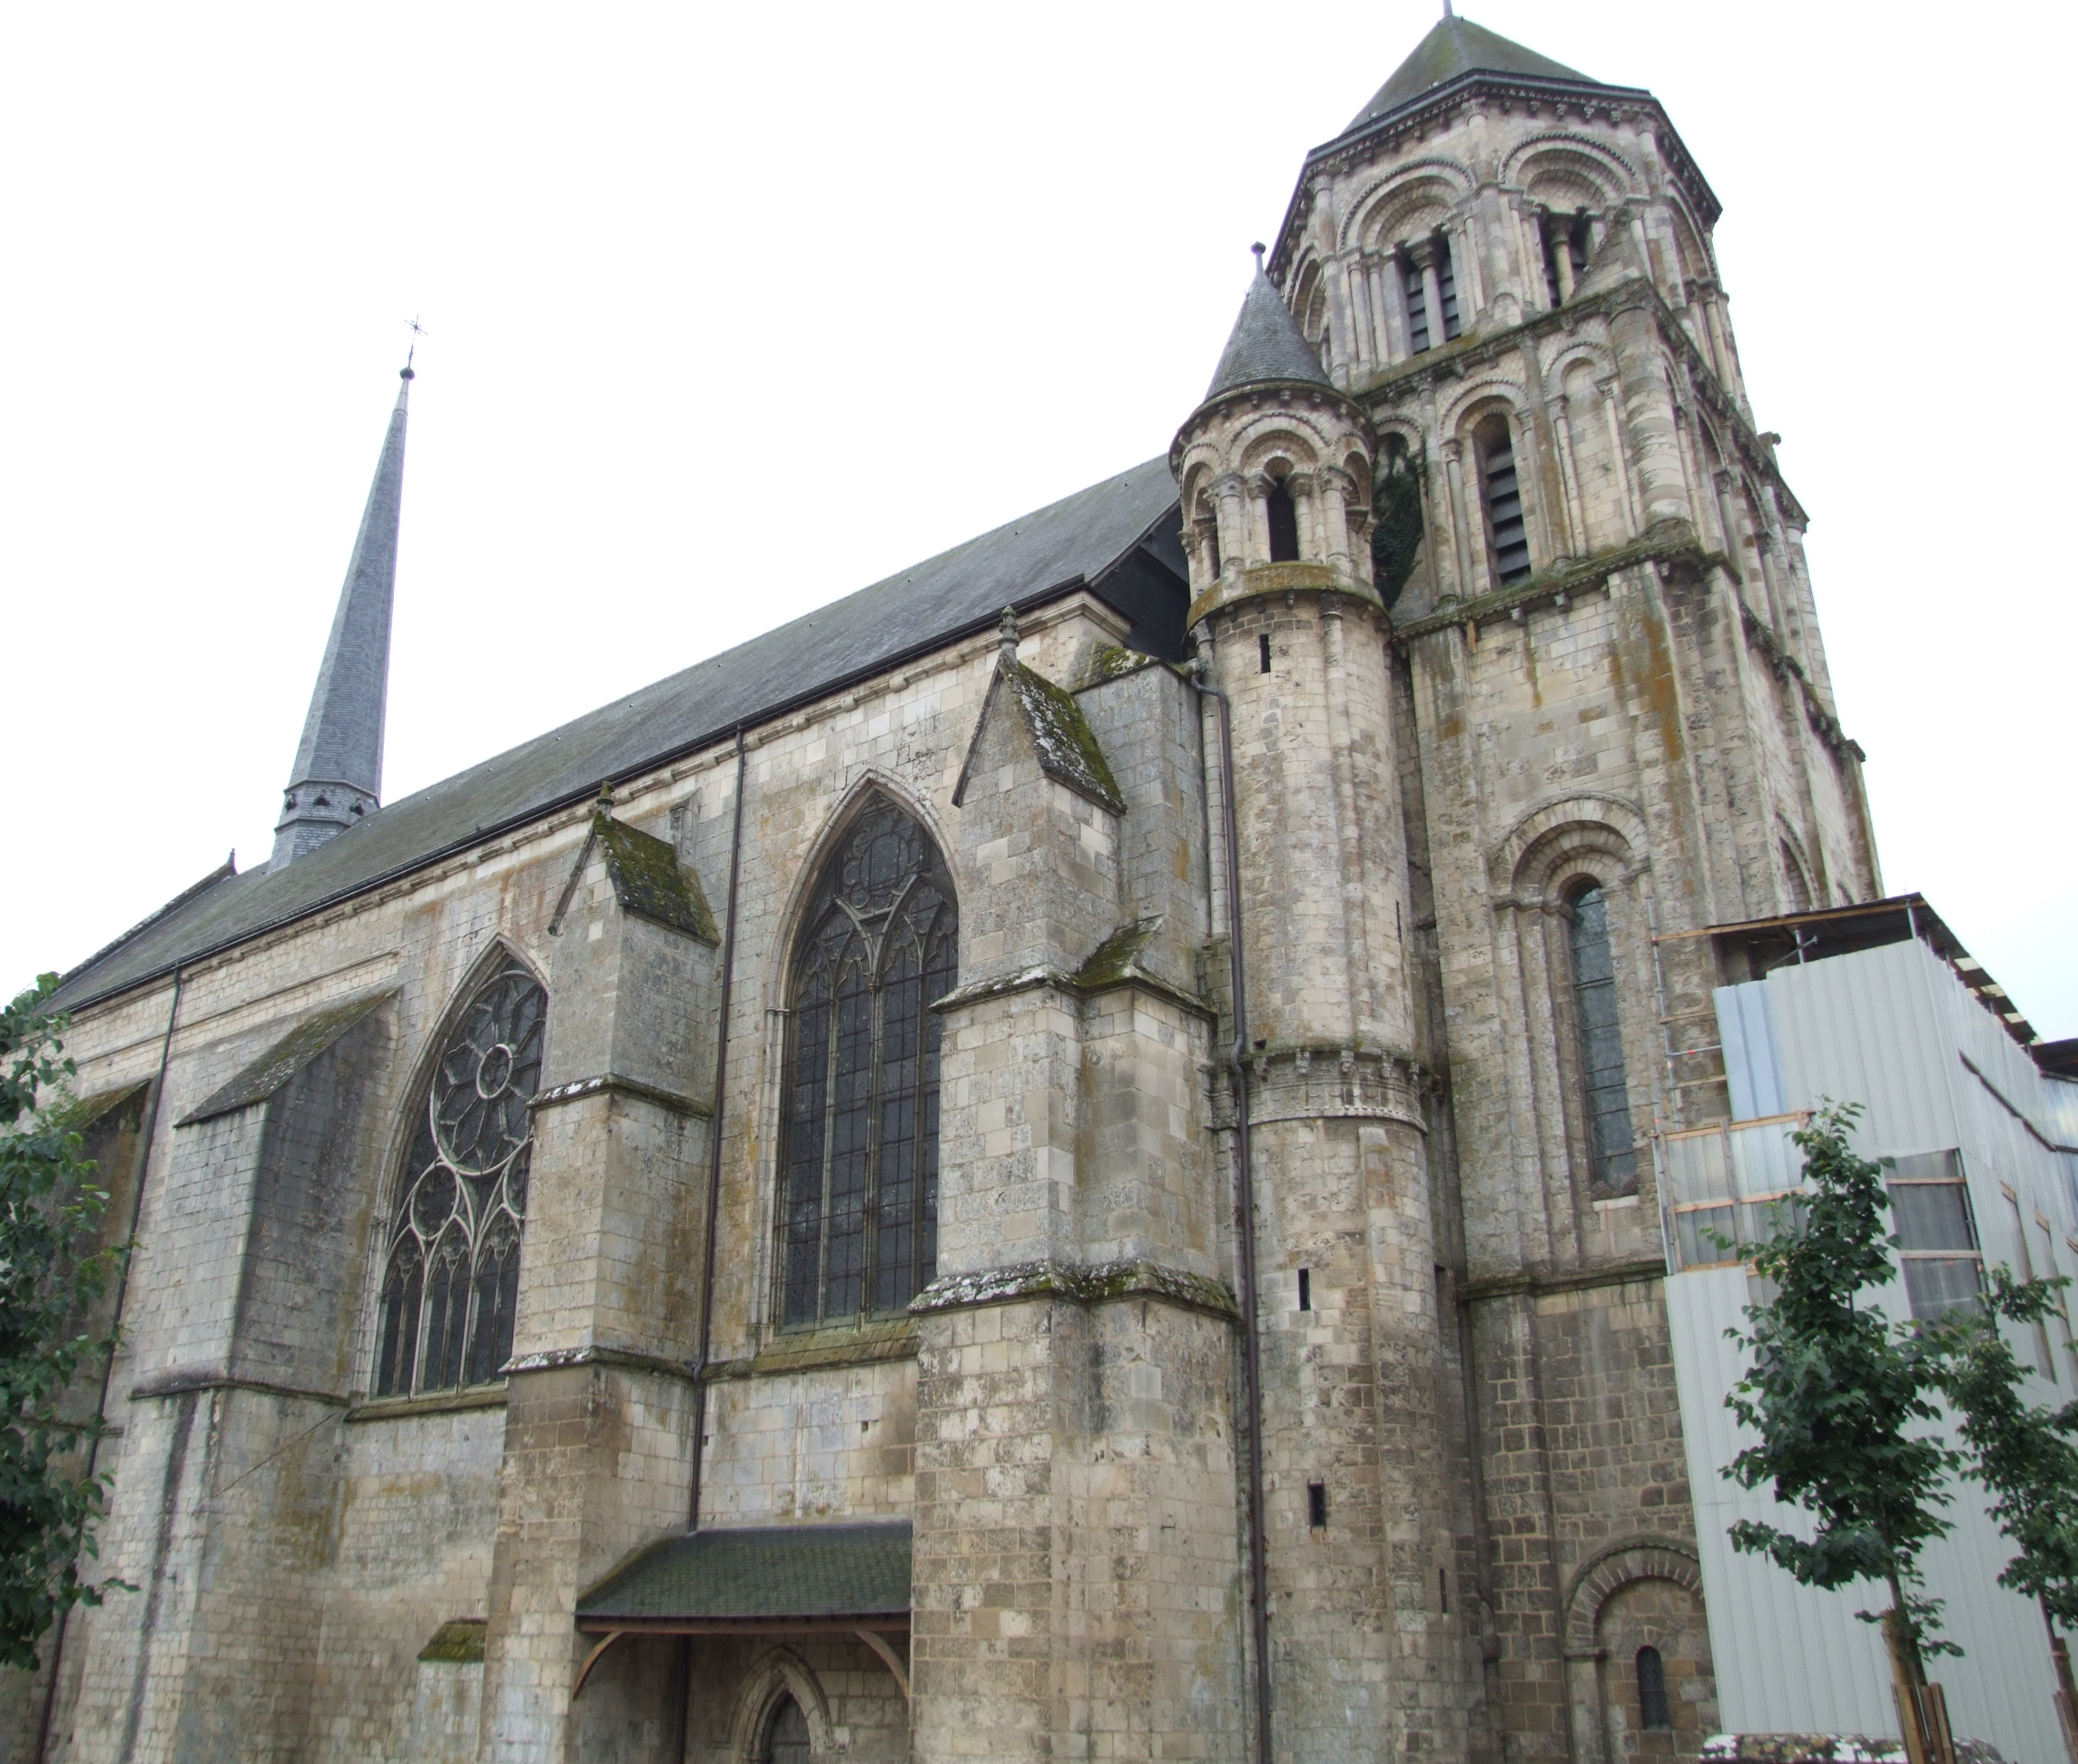
Monastery of St. Croix of Poitiers (est. 6th century)
Church of St. Radegonde
Abbess Isabeau (1466)
Jennifer Edwards, Superior Women: Medieval Female Authority and in Poitiers’ Abbey of St. Croix (2019)

Slide 10
Catherine of Siena (1347-1390)
Merchant family
Dominican order (founded 13th c)
Dominican tertiary
1367: Vision of Jesus

Slide 11
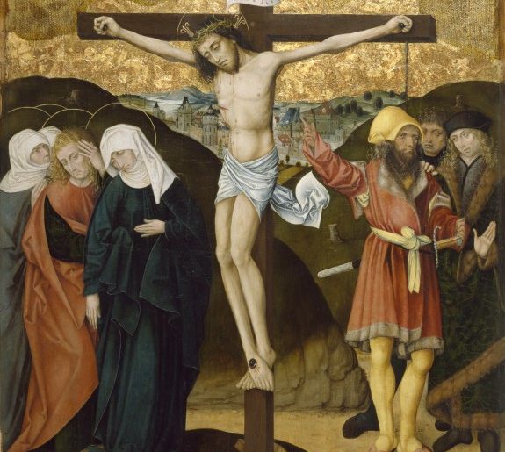
Passion of Christ Altarpiece, Germany,
1480-95

Slide 12
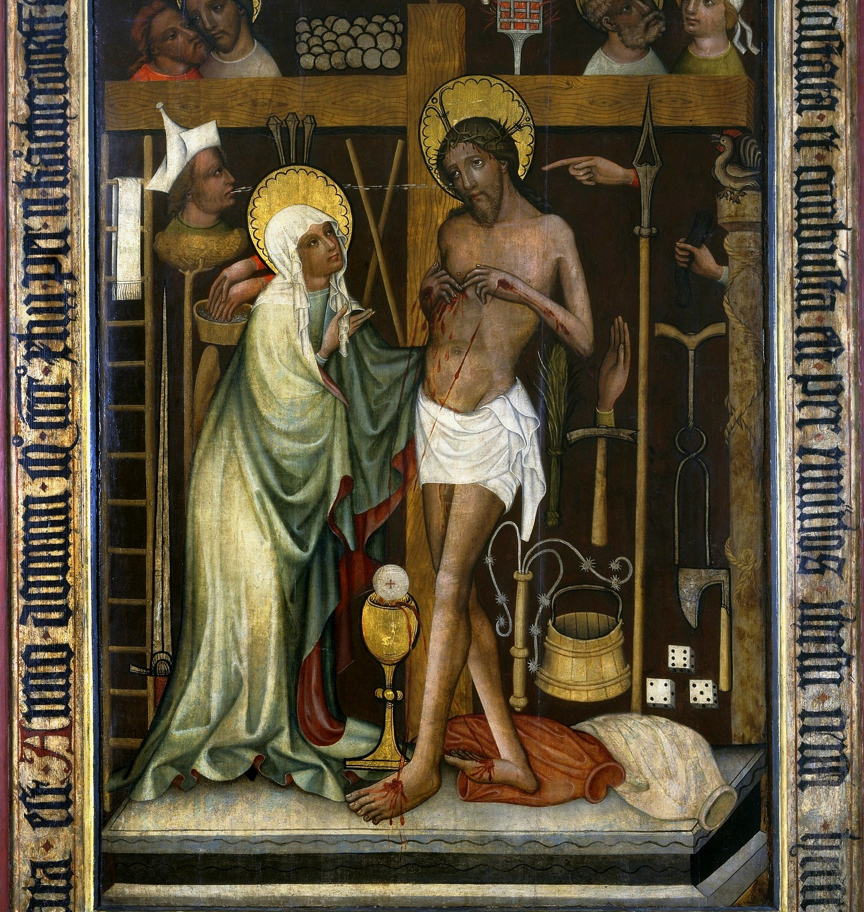
Caroline Walker Bynum, Holy Feast and Holy Fast: The Religious Significance of Food to Medieval Women (1987)
Eucharistic devotion
Eucharistic Man of Sorrows,
Poland (1443)

Slide 13
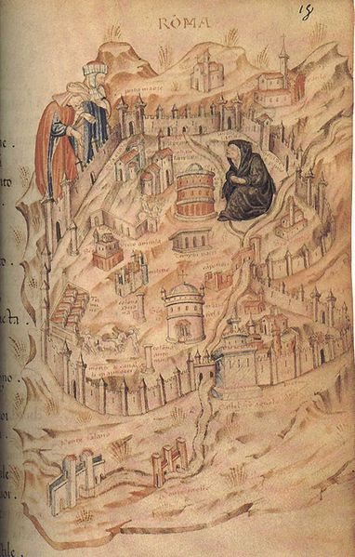
1305: Papacy moved to Avignon, France (Clement V)
1378: Disputed papal election = 3 popes (Urban VI and 2 more)
1417: Dispute settled = one pope (Martin V)
1376: Papacy returns to Italy

Slide 14
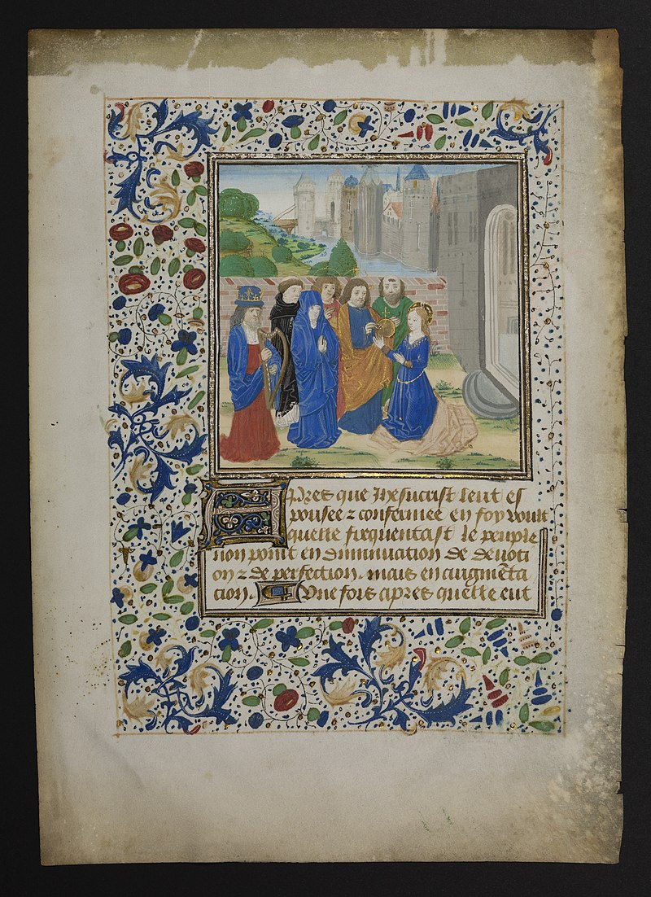
Wrote (dictated?) 350 letters
To popes, bishops, archbishops, cardinals, political figures
Men and women

Slide 15
Margery Kempe (1373 to after 1438)
Mystical visions of Christ and Virgin Mary
Married woman
14 children
Pilgrimage to England, Jerusalem, Santiago de Compostela

Slide 16
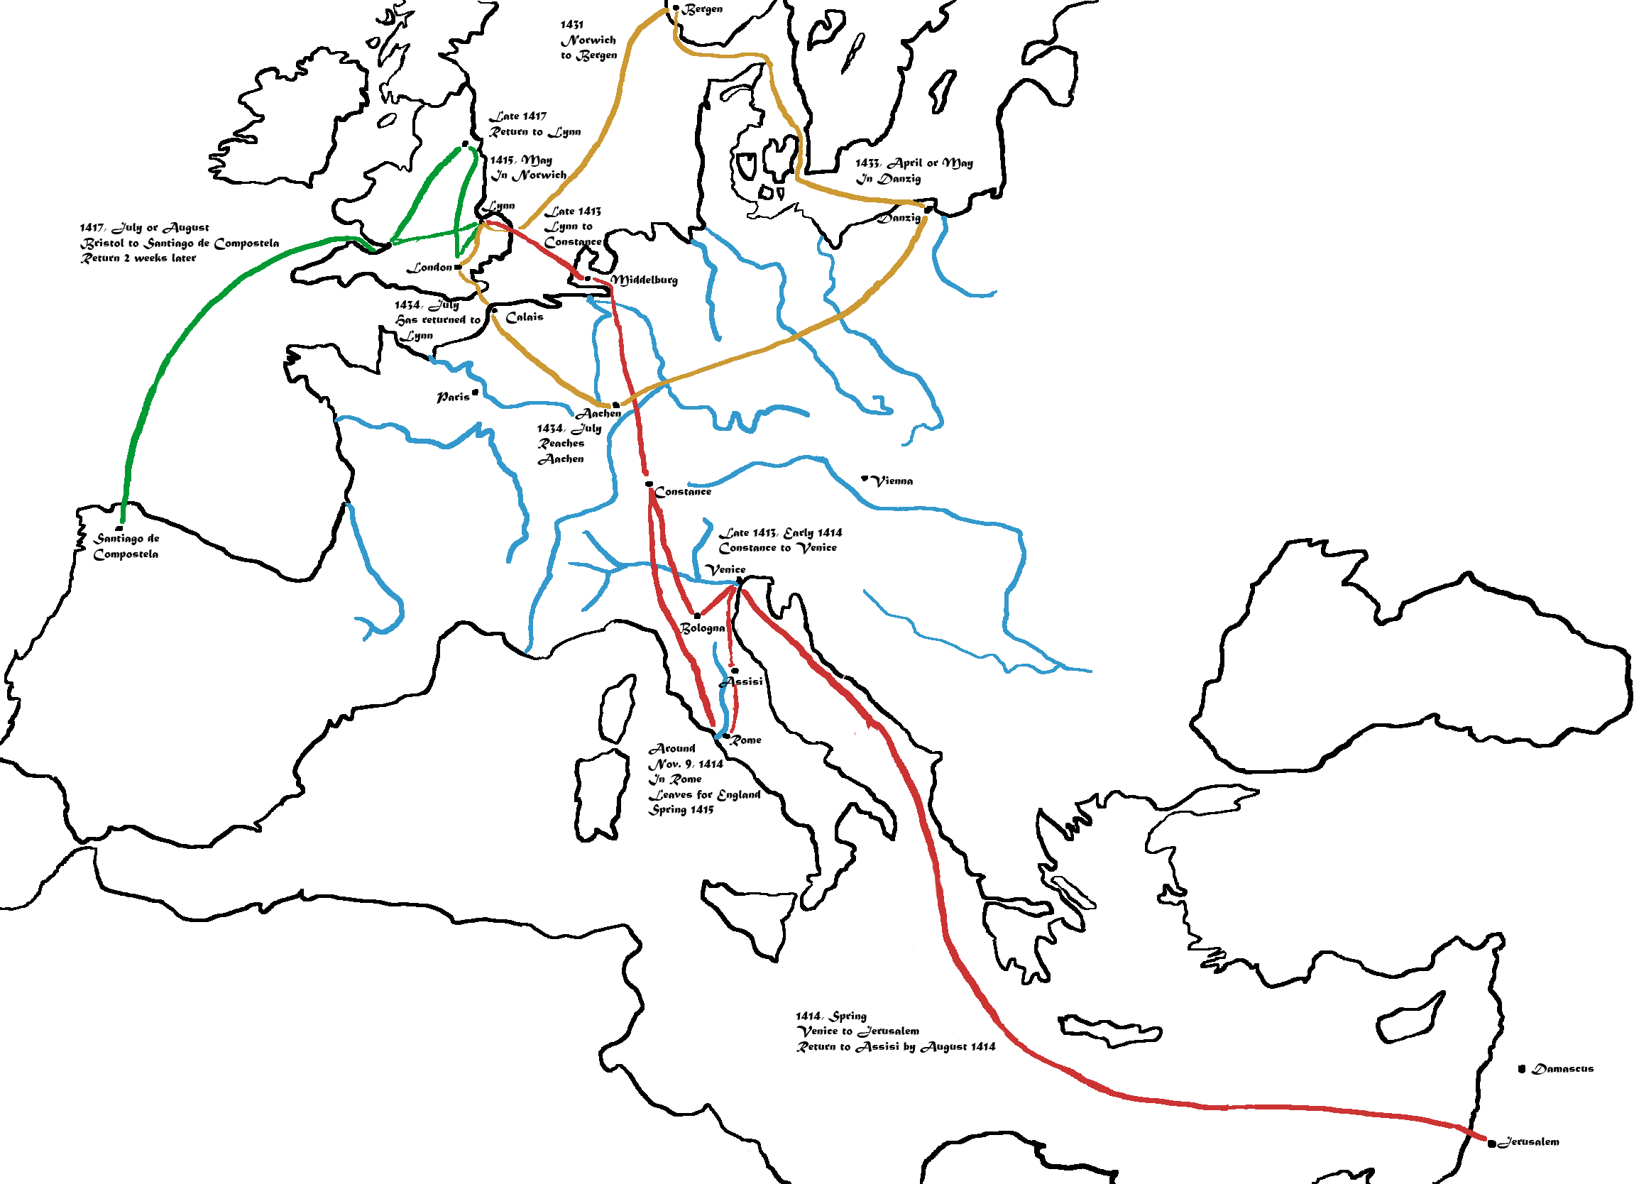

Slide 17
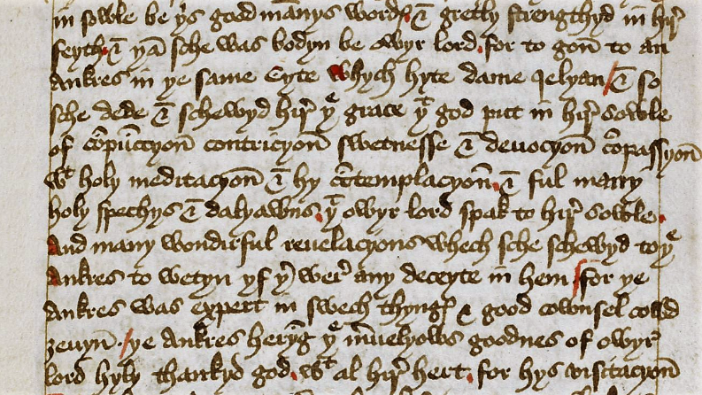
Book of Margery Kempe, around 1440
hagiography

Slide 18
Women and Heresy: Cathars
Heresy vs. orthodoxy
12th to 15th centuries
Cathars
Deny sacraments
Deny crucifixion and resurrection
Role for women

Slide 19
Christian Women’s Religious Experiences:
Catherine of Siena
and Margery Kempe
Image: “The Mystical Marriage of Catherine of Siena” by Giovanni di Paolo (1460)

