Slide 1
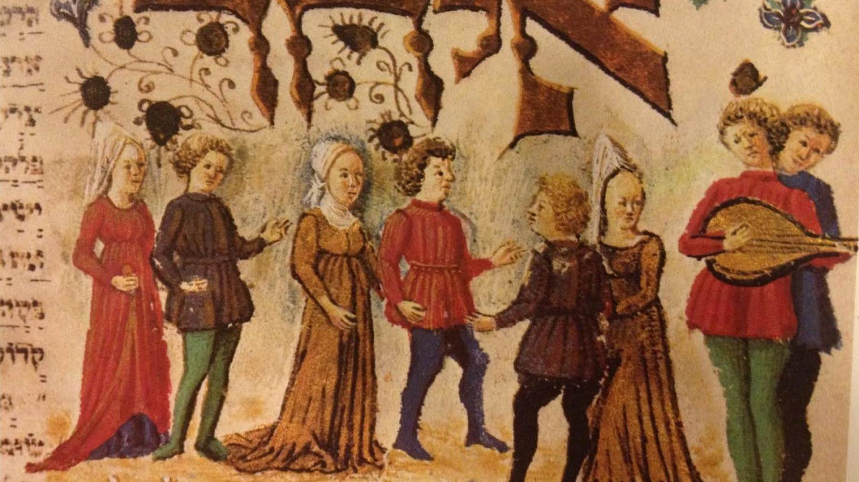
Jewish Women in medieval Europe

Slide 2
Jewish Religious Texts
TaNaKH = Hebrew Bible (Torah; Prophets; Writings)
Rabbinical Interpretations (Mishnah; Palestinian Talmud; Babylonian Talmud and others)
Responsa = Questions sent to rabbis and their responses

Slide 3
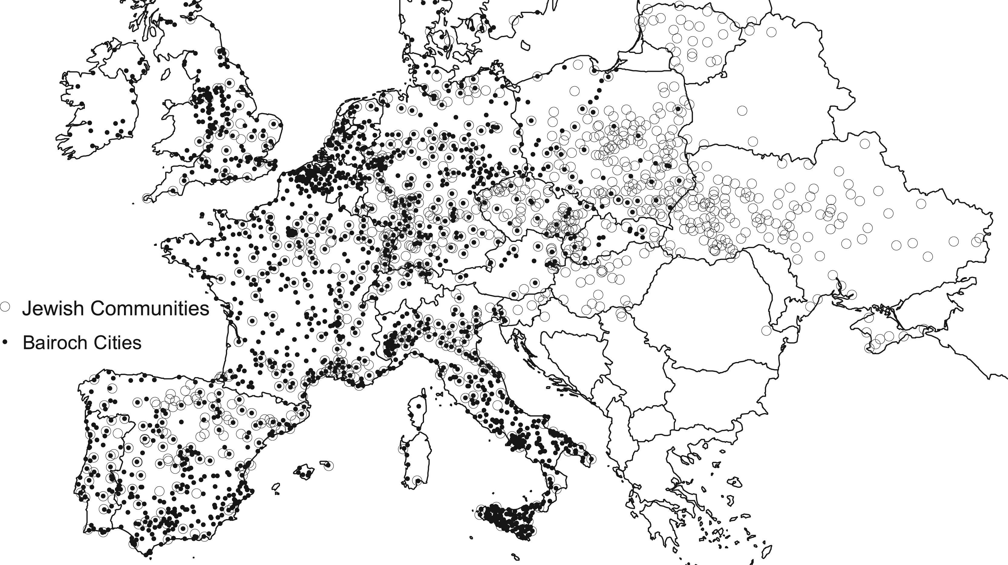

Slide 4
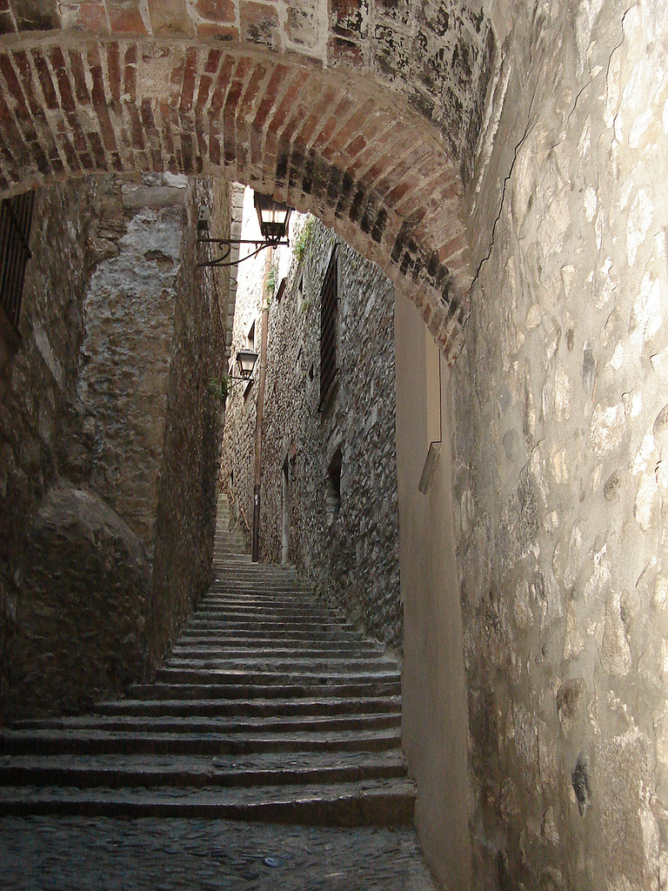
Jewish Communities
Communal autonomy
Freedom of religion
Increasing persecution
Expulsions: England (1290); France (1182; 1306; 1394); Spanish kingdoms (1492); Portugal (1497)
Ashkenazi (northern Europe); Sephardic (Spanish kingdoms and Portugal)
Jewish quarter, Girona, Spain

Slide 5
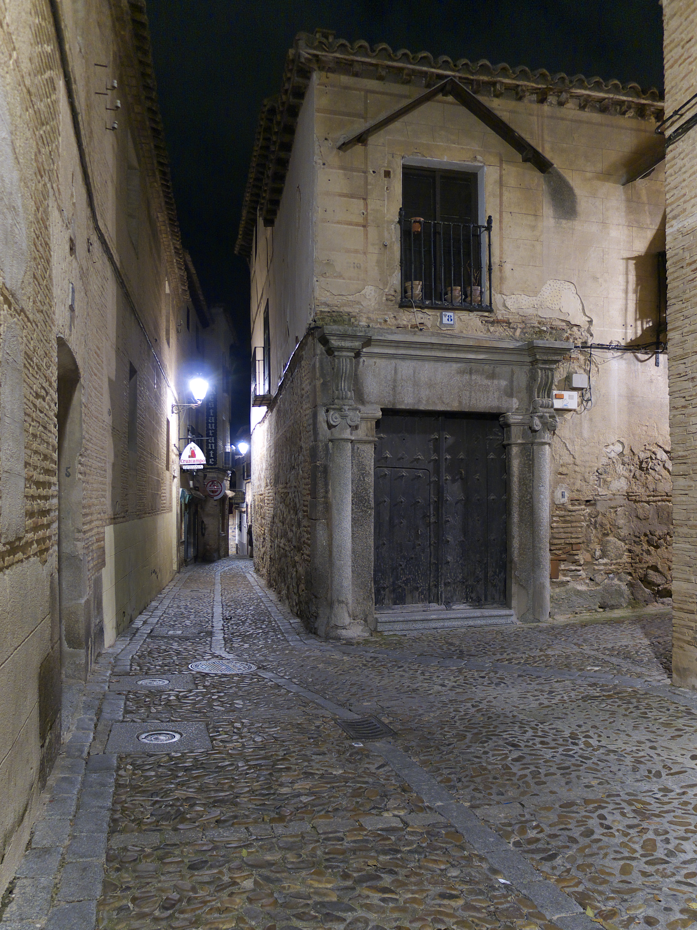
Jews in medieval Spain
From Roman imperial times (1st c. C.E.)
Communal autonomy and freedom of worship BUT paid heavy taxes
Under protection of monarchy
Jewish quarter, Toledo, Spain

Slide 7
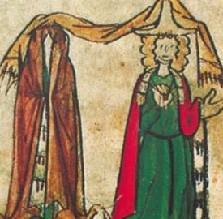
Marriage and Divorce
12 (girls) and 14 (boys)
Engagement (shiddukhin)
Betrothal (erusin)
Wedding (huppah)

Slide 8
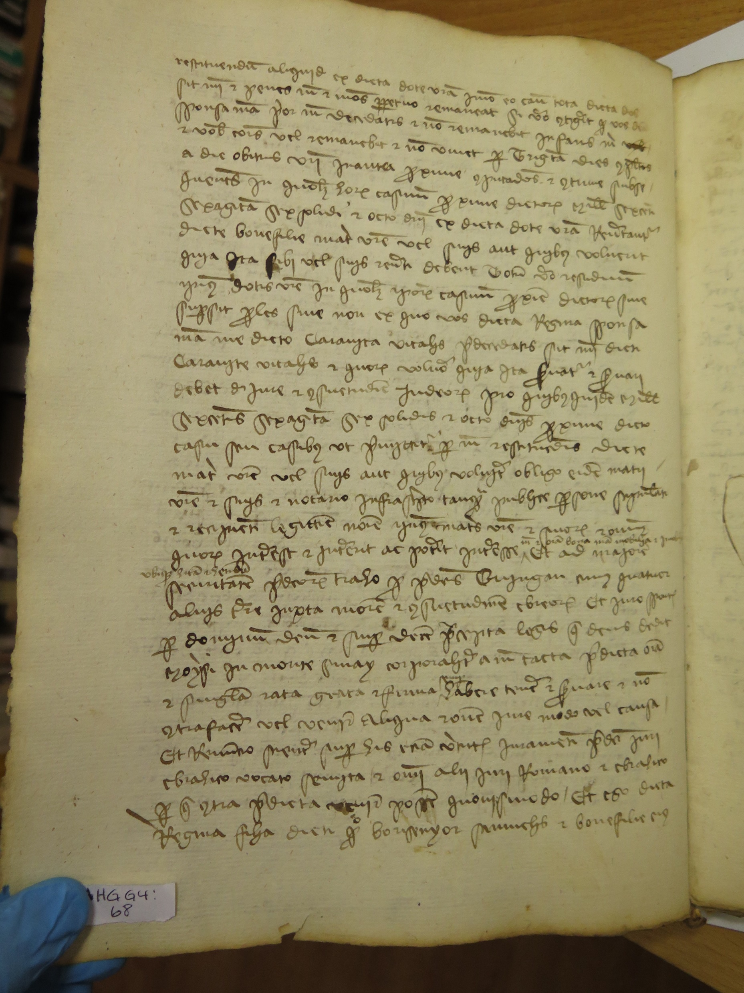
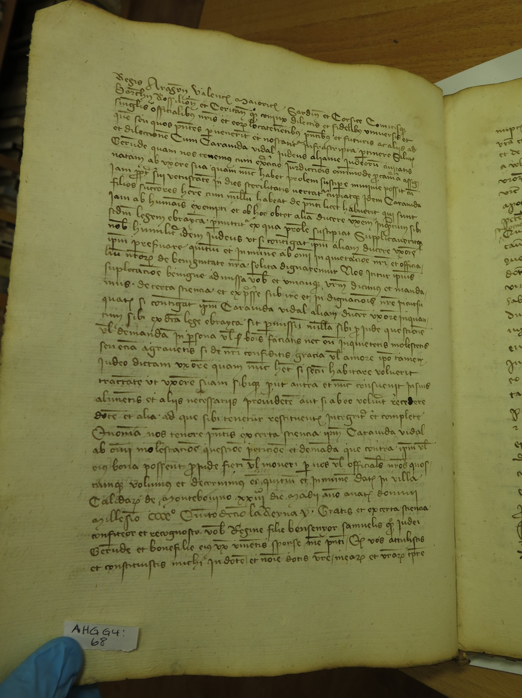
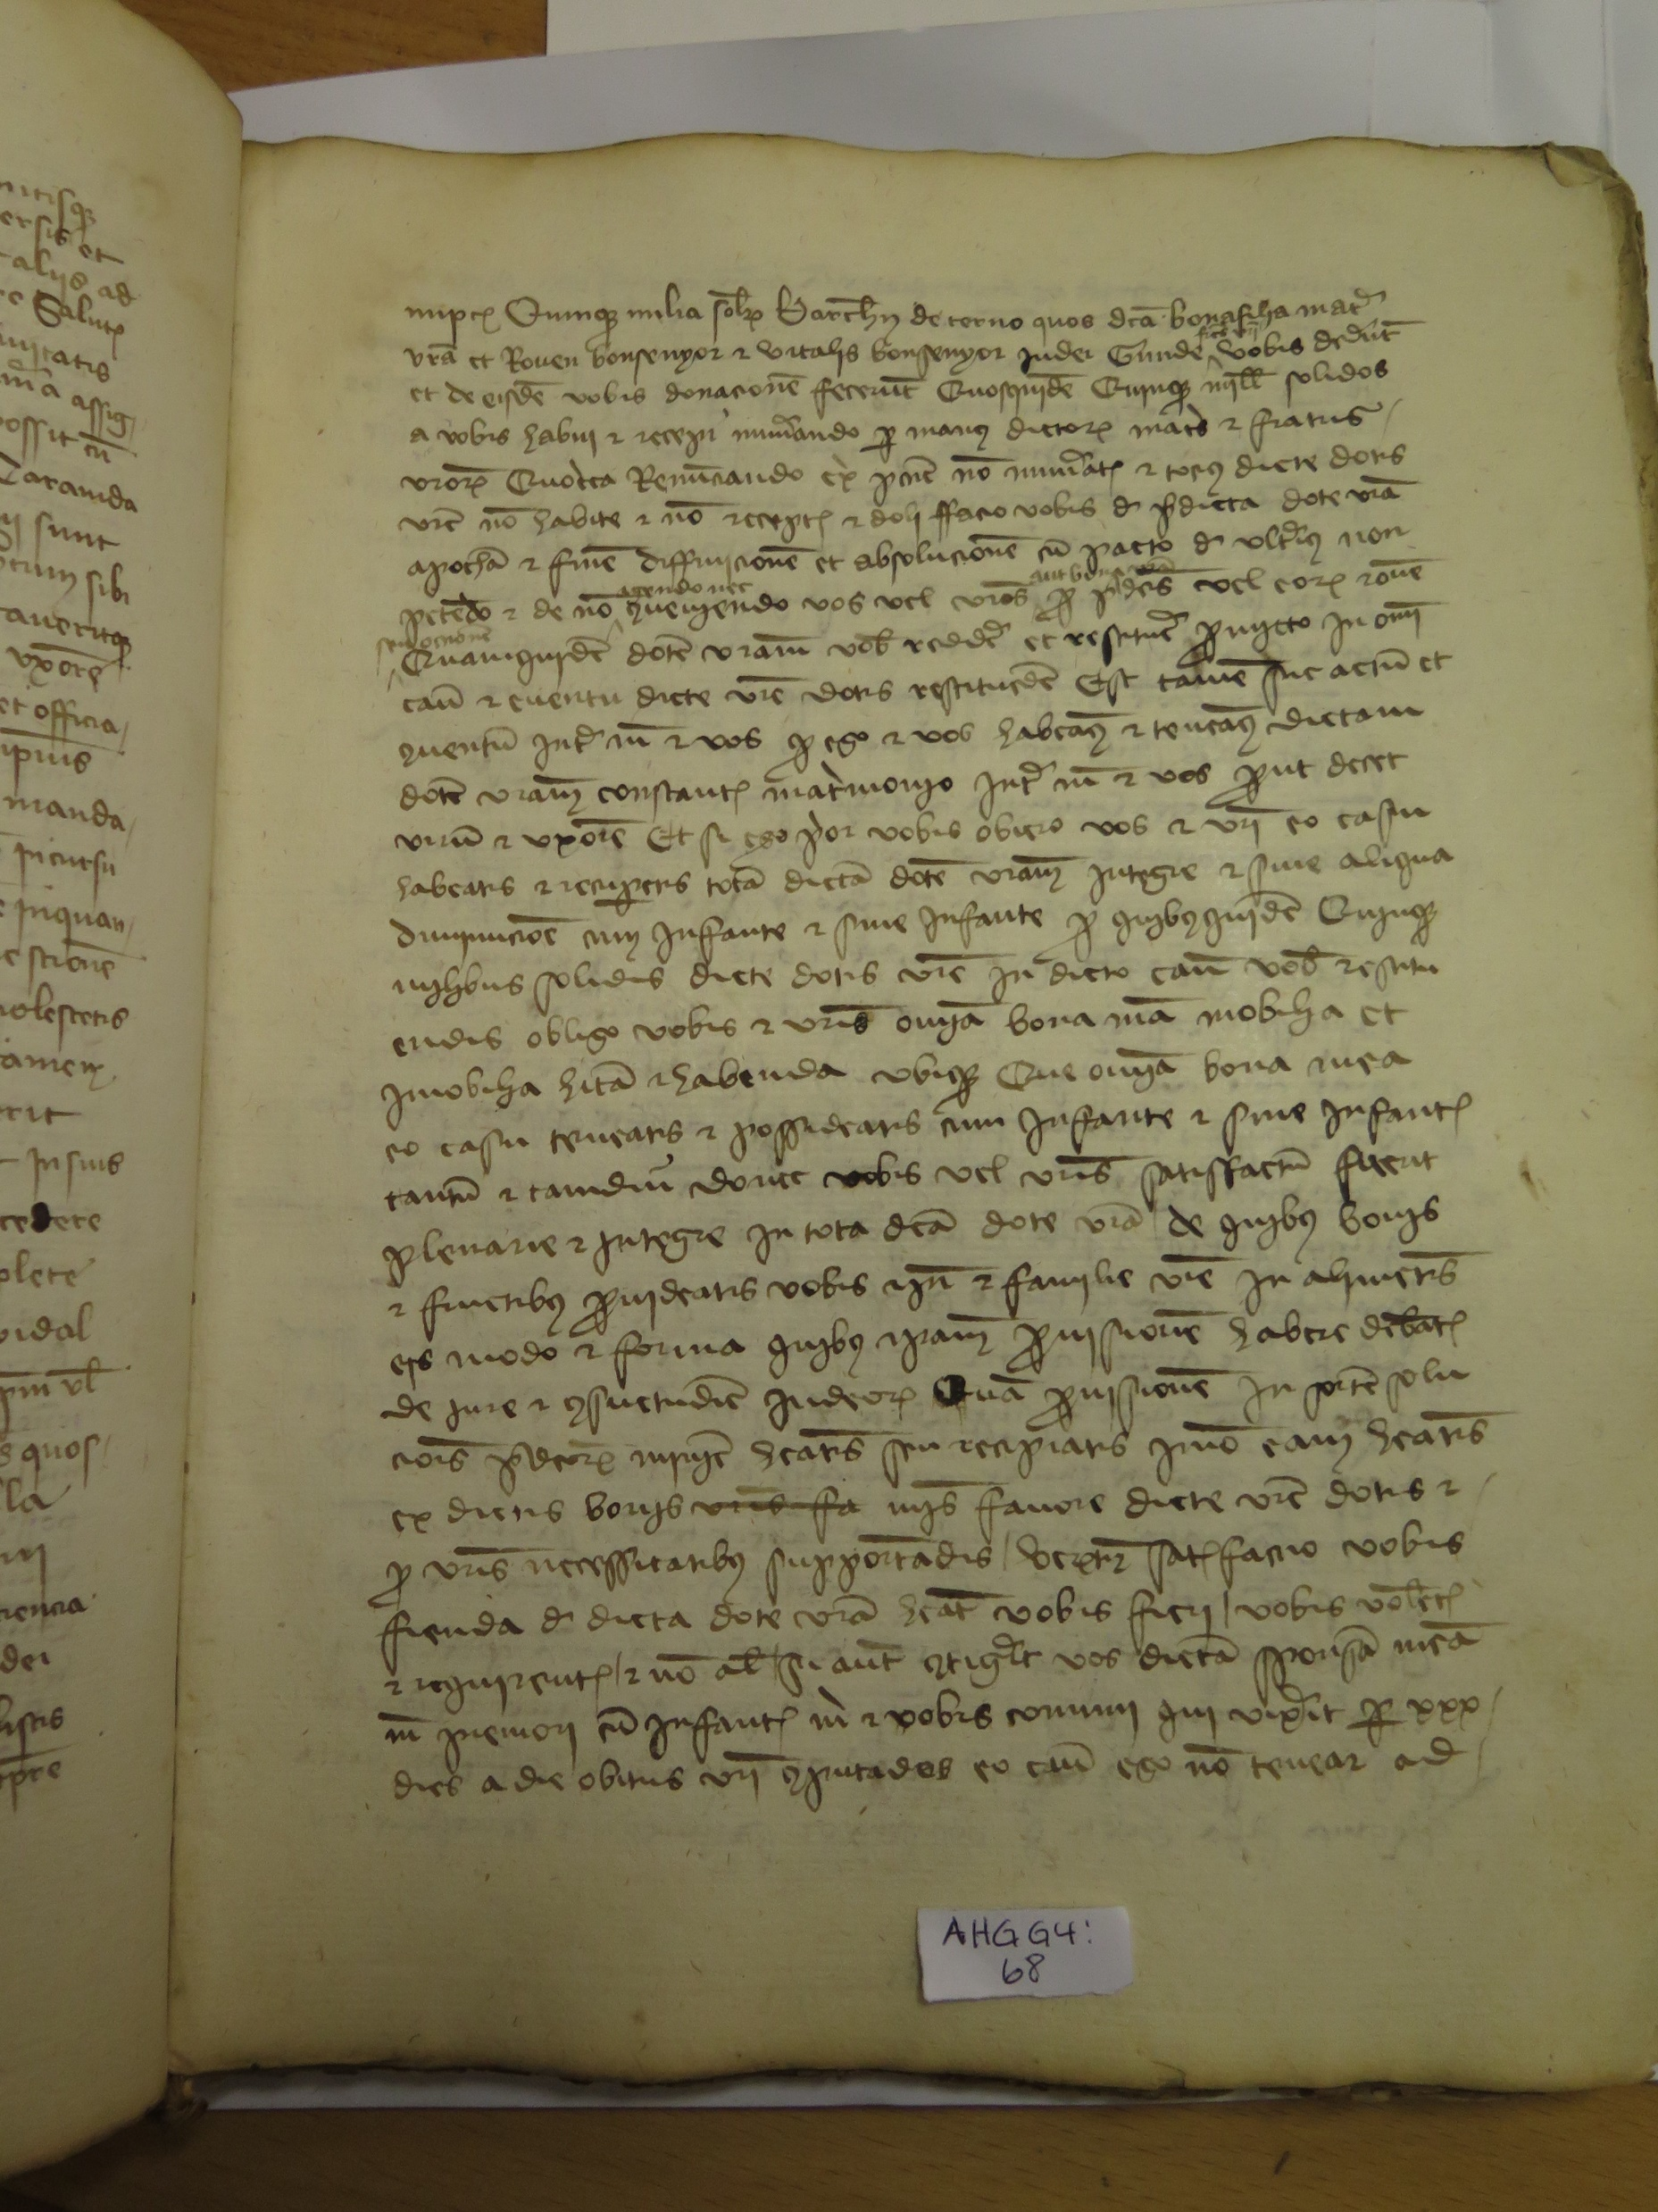
Ketubbah = dowry contract

Slide 9
Levirate Marriage (Yibbum)
“When brothers dwell together and one of them dies and leaves no son, the wife of the deceased shall not be married to a stranger, outside the family. Her husband’s brother shall unite with her: he shall take her as his wife and perform the levir’s duty. The first son that she bears shall be accounted to the dead brother, that his name may not be blotted out in Israel.” (Deuteronomy 25: 5-6)
“Rebellious Wife”

Slide 10
Polygamy (Polygyny)
Husband to take second wife
Outlawed in Ashkenazi communities by Rabbi Gershom (960-1028)
Continued in Sephardic communities (e.g. Crown of Aragon)
Special license for cases of infertility

Slide 11
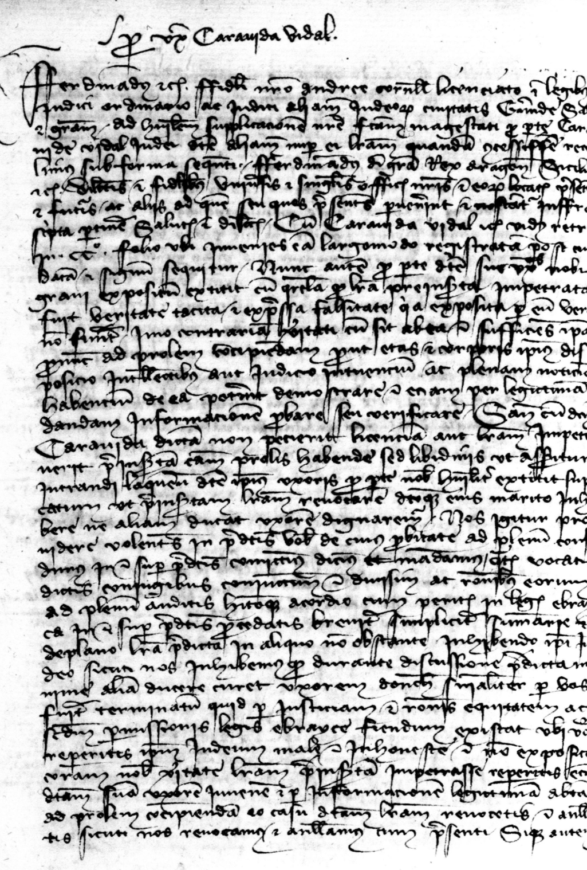
Caravida, Bonafilla, and Regina Vidal (early 15th c. Girona)
December 1414: request for second wife
February 1415: Bonafilla opposes second marriage
May 1415: license to take second wife granted
June 1415: Caravida marries Regina
January 1416 to June 1417: Caravida converts to Christianity (divorce from Bonafilla?)
“arguments, resentment, and divorce”

Slide 12
Procreation and
Infertility
“Be fruitful and multiply and fill the earthy and conquer it.” (Genesis 1:28)
“A woman without children is like a dead person.”
(Judah the Pious, 12th c.)
“It is a man’s nature to conquer, it is not a woman’s nature.”
(Rashi, 12th century)

Slide 13
Divorce “Get”
Infertility of wife
Debate regarding wife’s agreement/permission
Not allowed for male impotence (although debated)

Slide 14
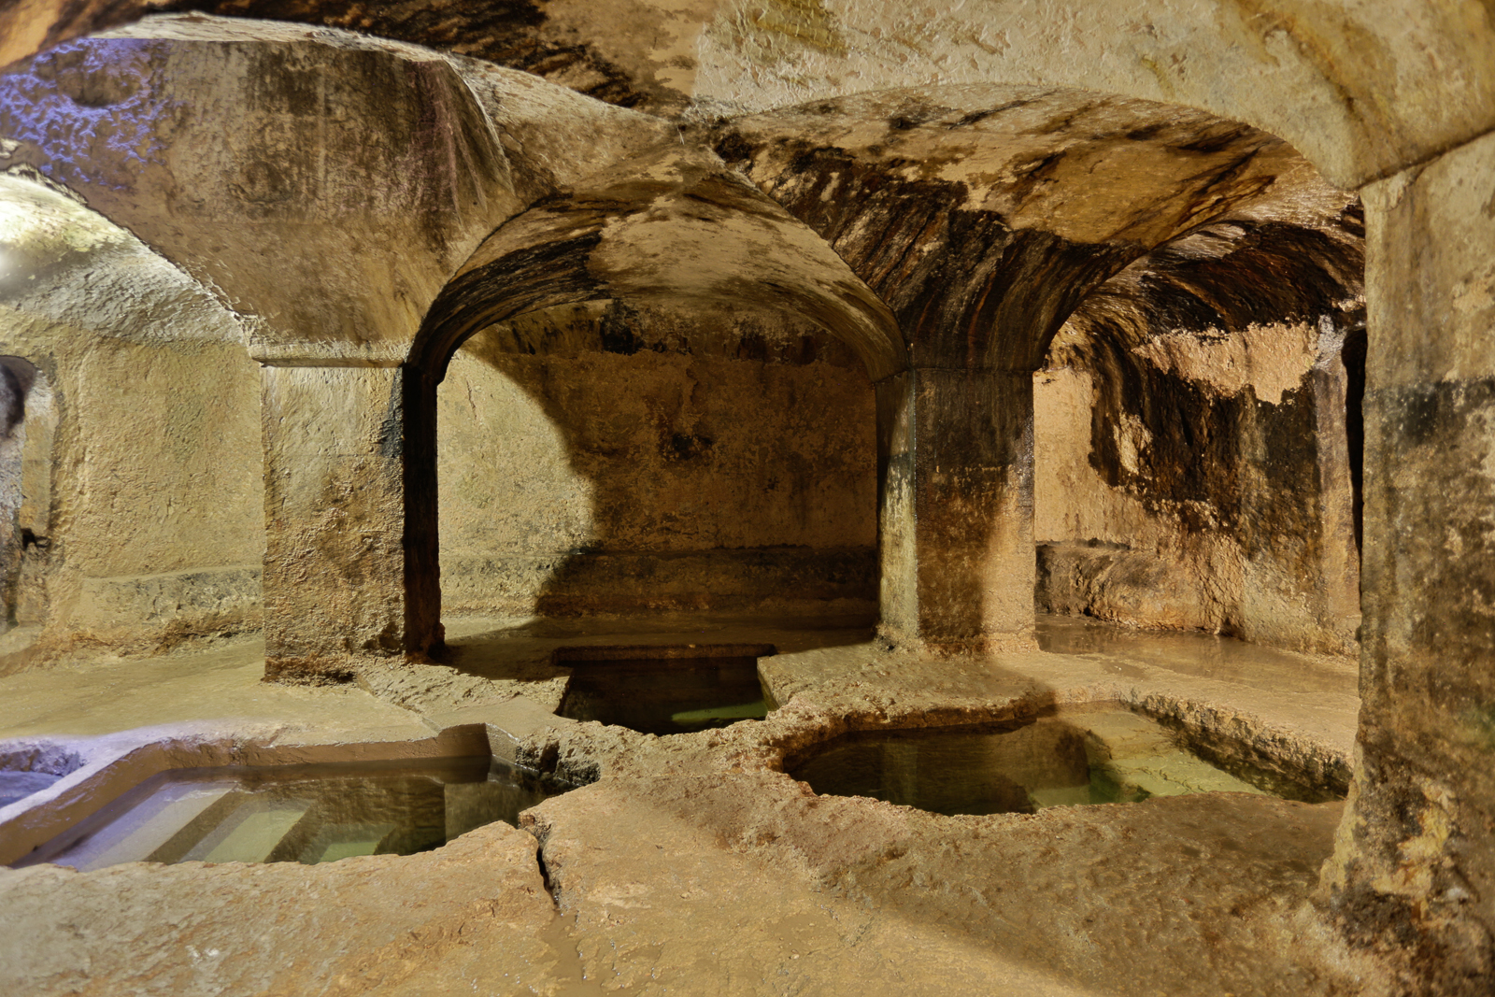
Ritual Purity
Talmud from Leviticus
Niddah
mikveh
Image: Mikveh from Sicily

Slide 15
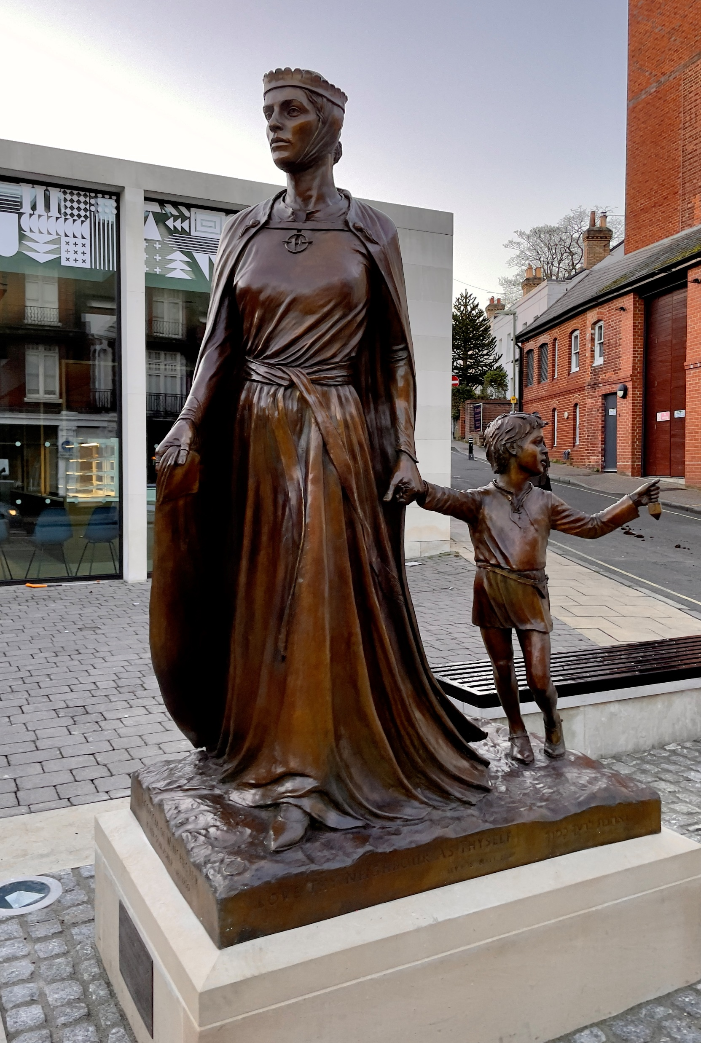
Licoricia of Winchester
(13th c. England)

Slide 16
Jewish Women’s Economic Activities
Moneylending
Artisanal production: weavers, silk and cloth dyers, silversmiths, coral cutters, button makers, peddlars
Medicine: Chava of Manosque (14th c.); eye doctors in 15th c. Frankfurt

