Slide 1
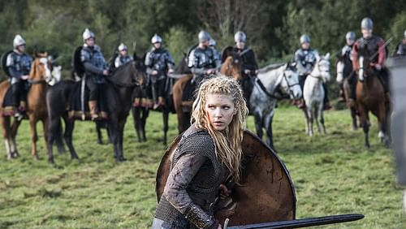
Warrior Women in medieval Europe

Slide 2
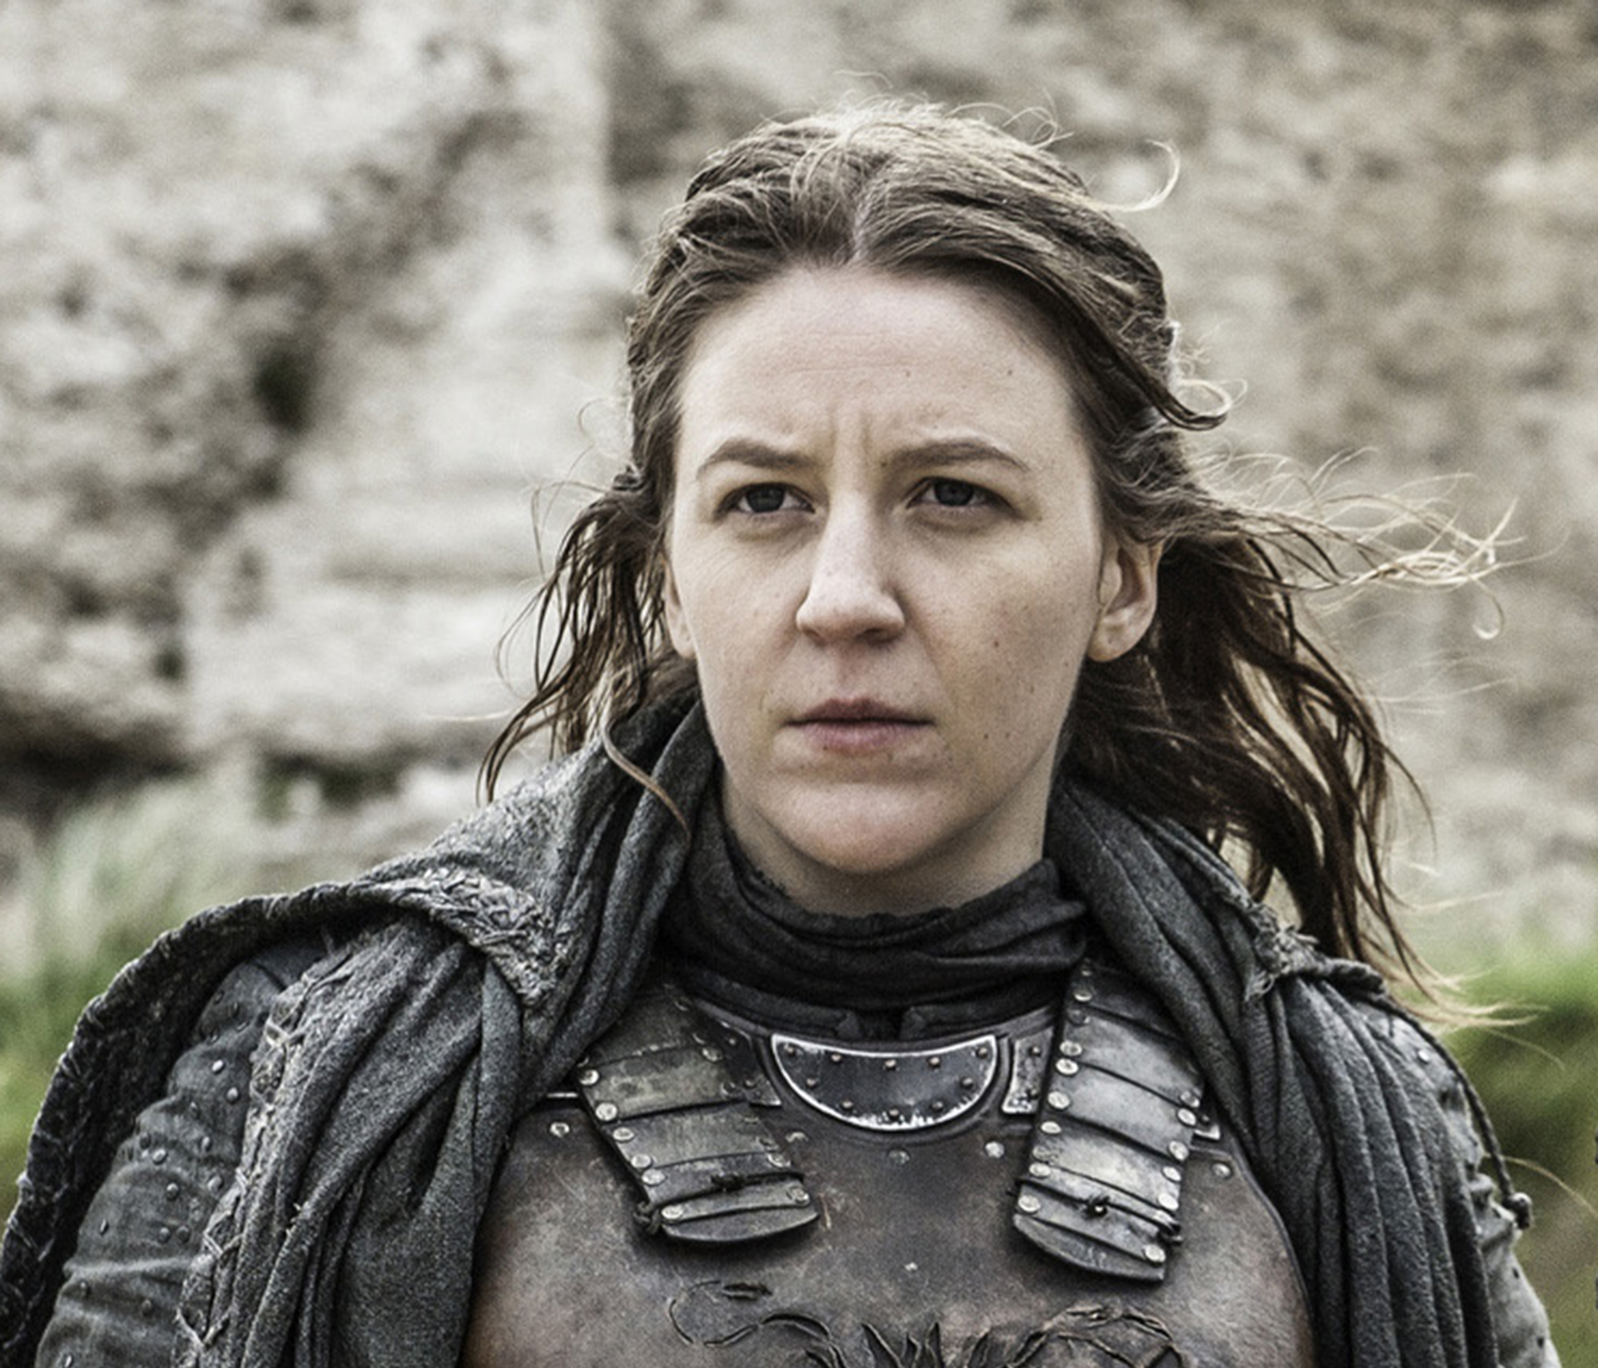
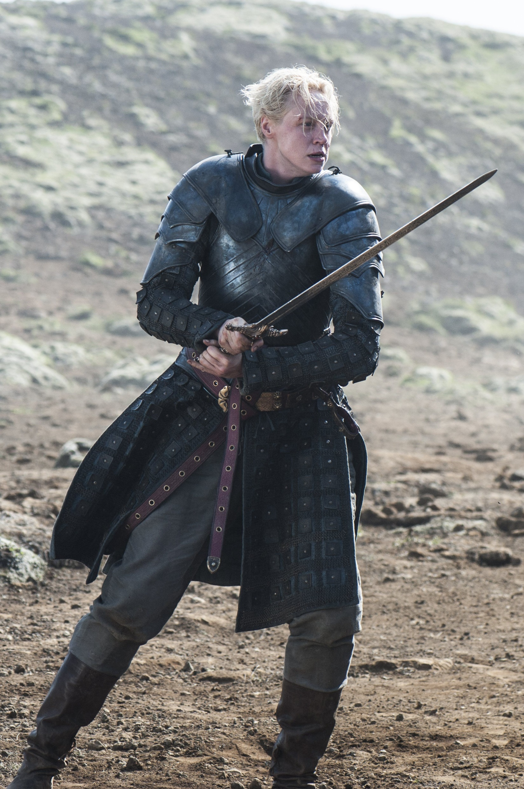

Slide 4
“Warfare is the one human activity from which women, with the most insignificant exceptions, have always and everywhere stood apart. Women look to men to protect them from danger…women, however, do not fight. They rarely fight among themselves and they never, in any military sense, fight men. If warfare is as old as history and as universal as mankind, we must not enter the supremely important limitation that it is an entirely masculine activity.”
John Keegan, A History of Warfare (1993)

Slide 5
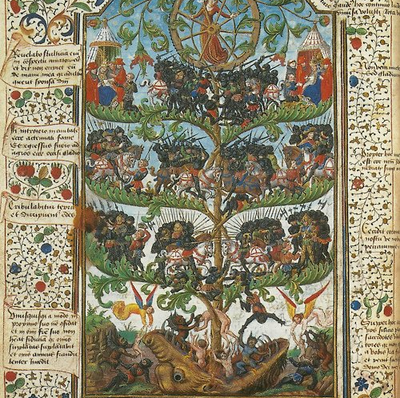
Honoré Bouvet,
The Tree of Battles
(14th century)
“what people can and must be restrained from going to war”
“women, old men, the ill, the deaf and blind, or people too young who cannot endure armor”

Slide 6
Today’s Focus
Viking women in sagas and gravesites
“Exceptional” women: Joan of Arc and Matilda of Canossa
Women in military manuals

Slide 7
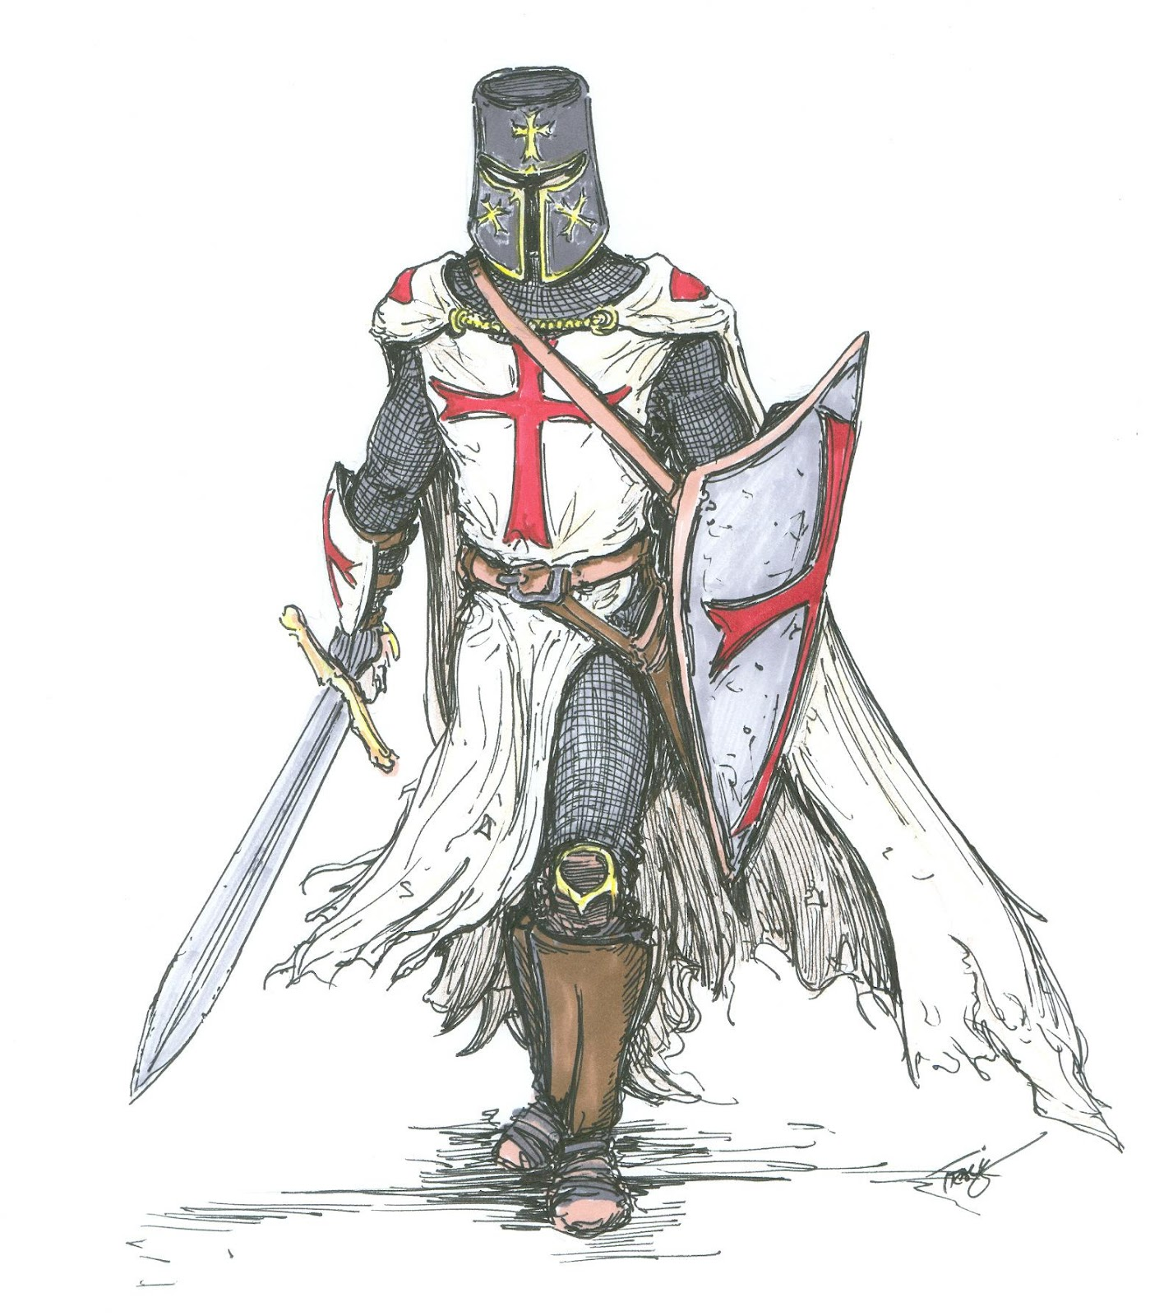
Medieval Warrior?

Slide 8
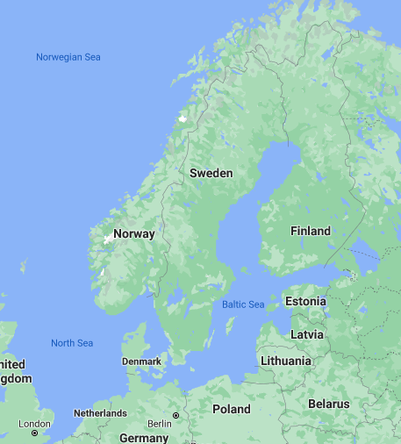
Vikings
Scandinavia – Denmark, Norway, Sweden
Vikingr – someone who travels by water; “pirate”, “sea-robber”, raider

Slide 9
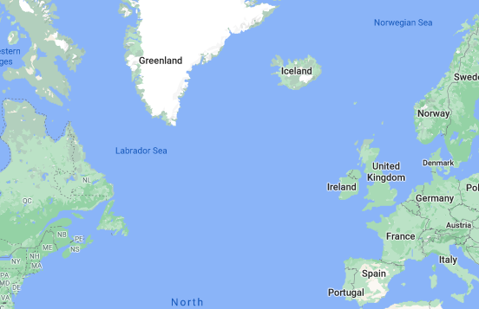
Orkney, Shetland, and Faroe Islands
Iceland
Greenland
Vinland

Slide 10
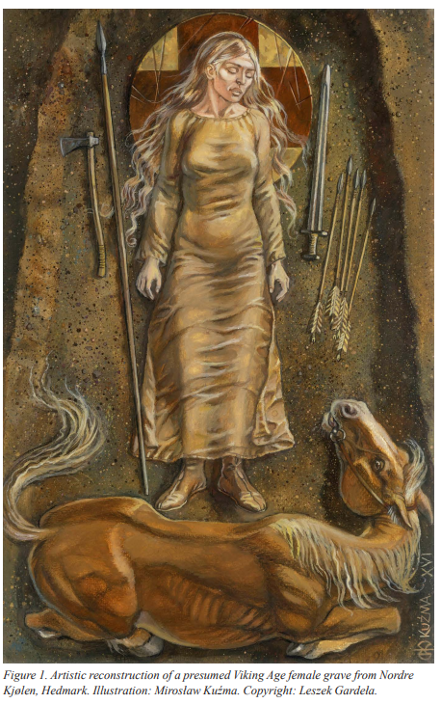
Viking Women: Archeology
Swords, spearheads, shields, axe heads, arrowheads

Slide 11
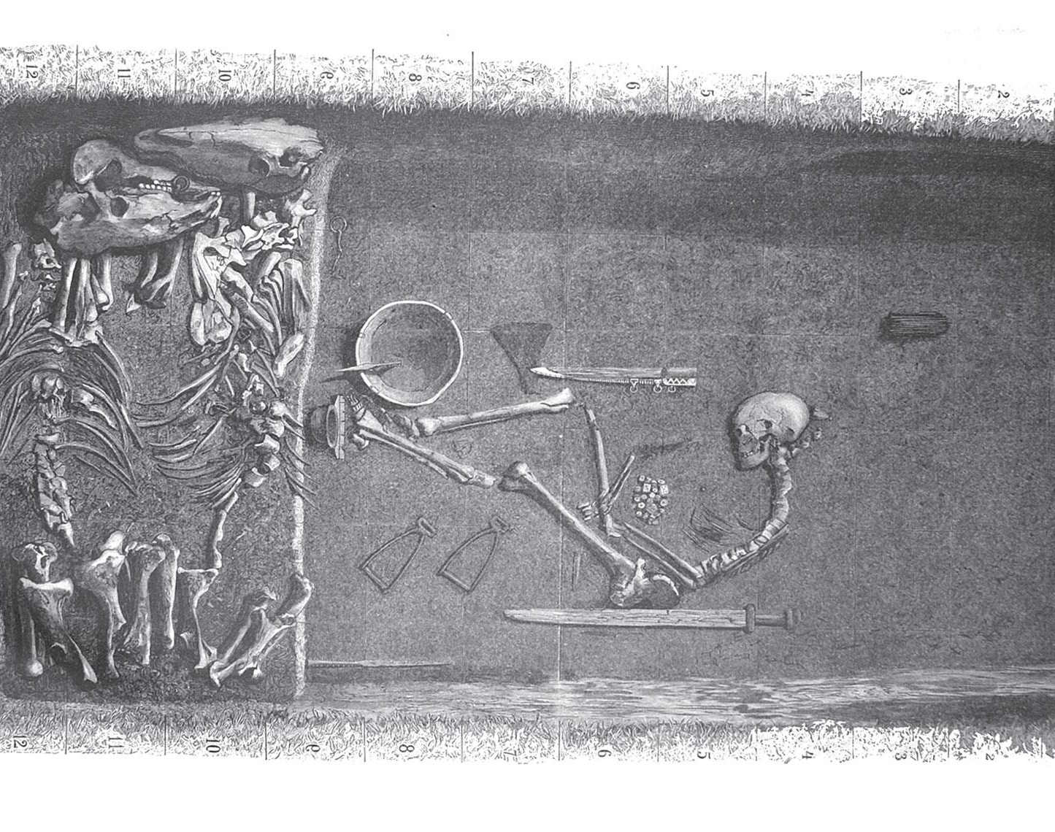
Bj. 581 in Birka, Uppsala, Sweden
First excavated 1878
DNA typing 2017

Slide 12
More questions…
but how do we answer them?
Was this person biologically female but socially male?
Should we be considering that they were gender fluid?
Should we consider them as a transgender man?

Slide 13
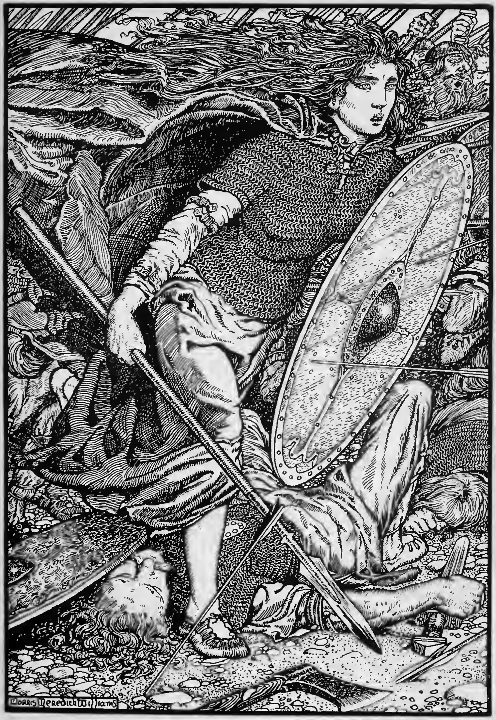
Viking Women: Sagas

Slide 14
Types of Sagas
Tales of Scandinavian Kings (12th to 14th century)
Viking settlement in Iceland (9th to 11th century)
Viking myth and legend

Slide 15
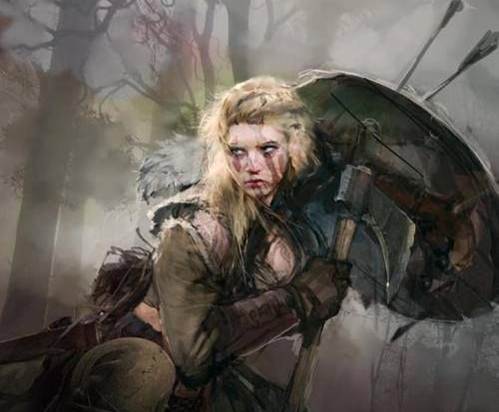
Hervör
“functional son”

Slide 16
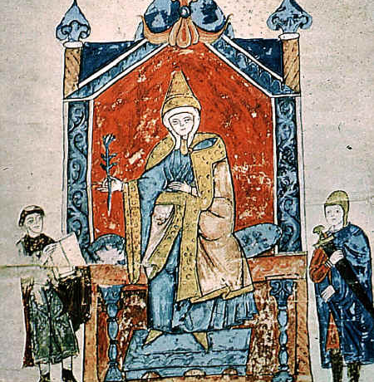
Exceptional Women:
Matilda of Canossa
(1046-1115)

Slide 17
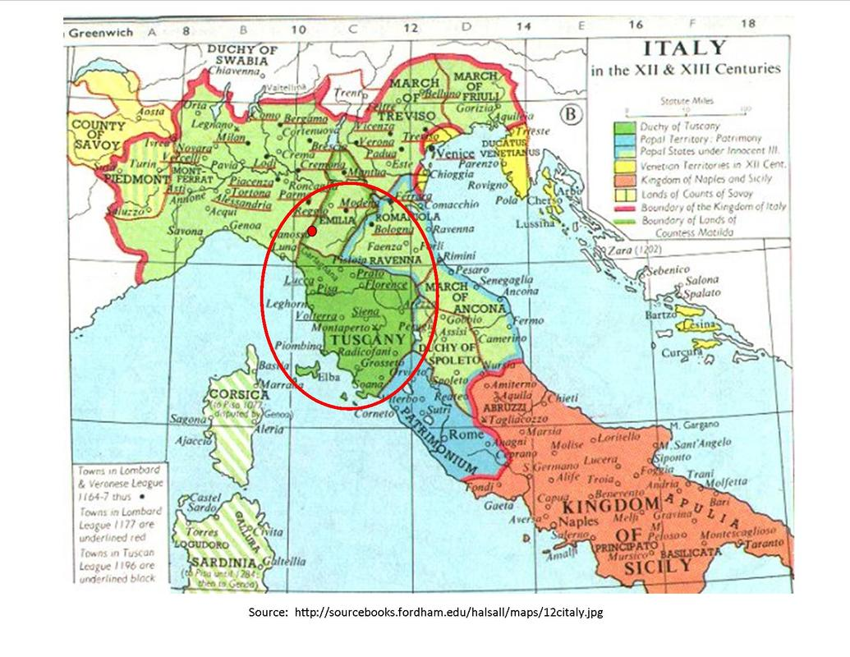
Conflict between Pope Gregory VII and Holy Roman Emperor Henry IV (1075-1099)
Tuscany, land controlled by Matilda

Slide 18
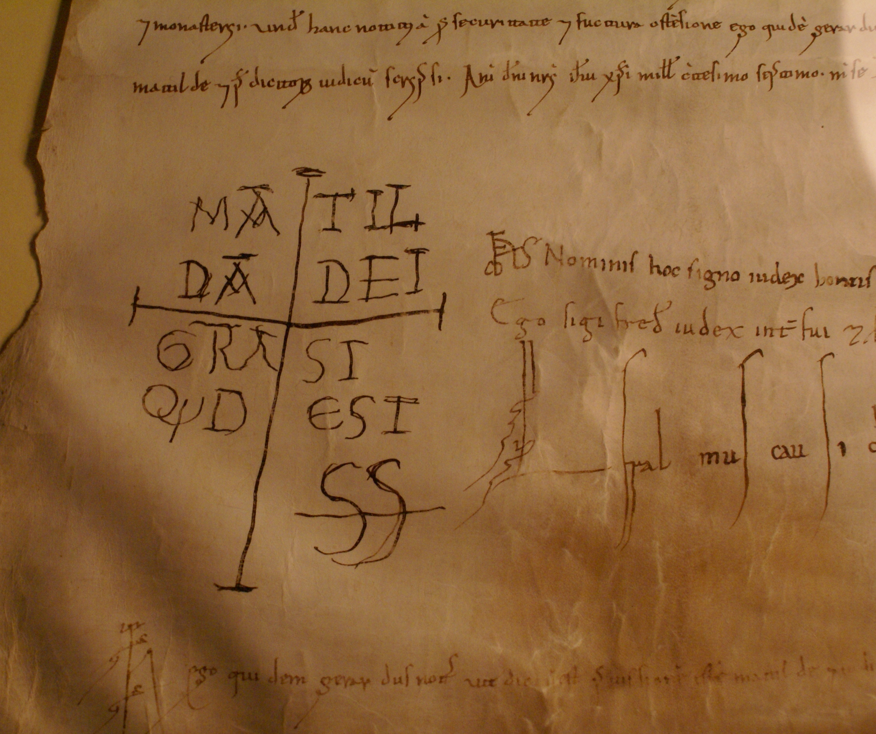
Matilda as Commander
Mustered armies
Fought defensive campaigns
Launched ambushes
Urban warfare
Defended and fortified castles

Slide 19
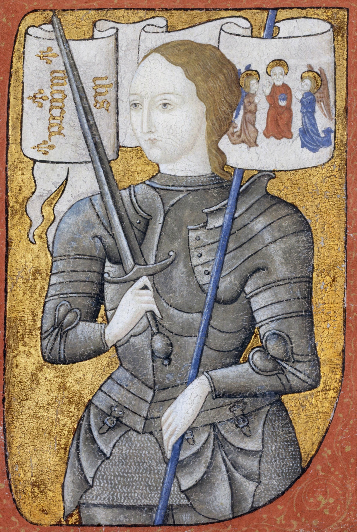
Exceptional Women:
Joan of Arc
(1412-1431)

Slide 20
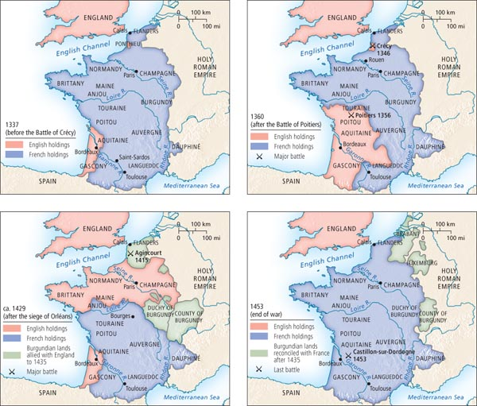
100 Years’ War
1337-1453
Charles VII, King of France

Slide 21
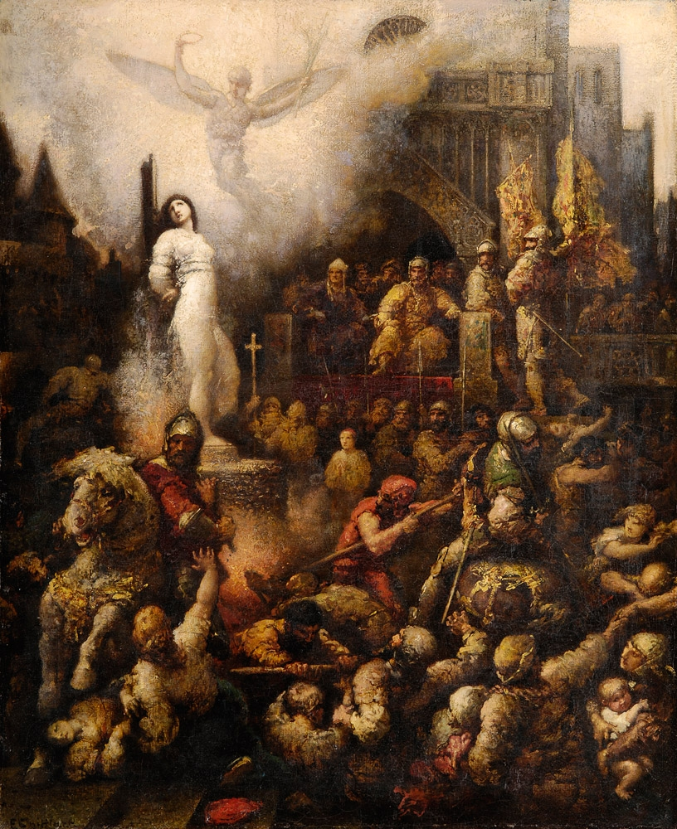
Executed May 30, 1431
Rouen, France
Canonized 1920

Slide 22
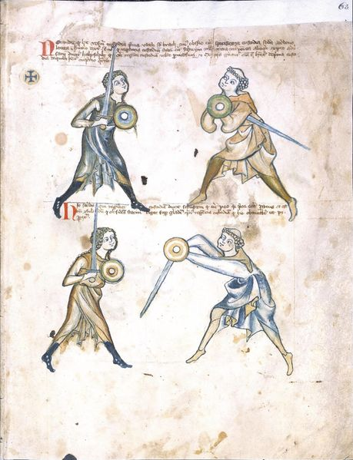
Military Manuals: Walpurgis Manuscript

Slide 23
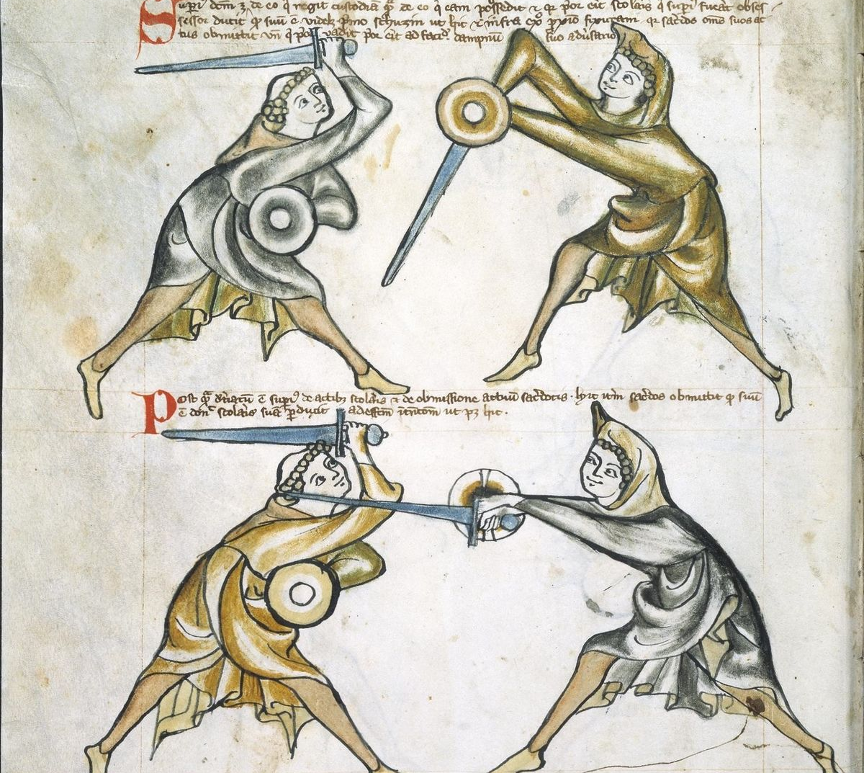
Royal Armories MS 1.33 (1270-1330)
Use of sword
and buckler

Slide 24
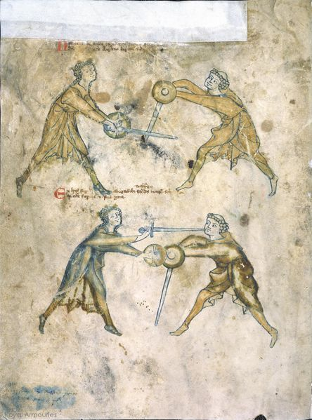

Slide 25
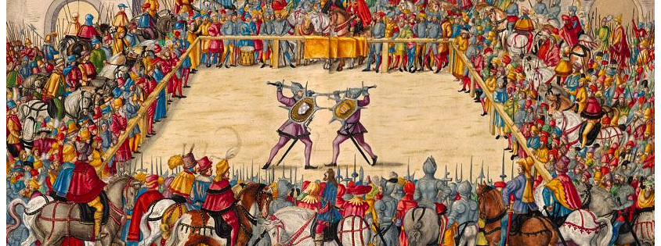
Judicial Duel between Marshal Wilhelm von Dornsberg and Theodor Haschenacker, Augsberg, 1409

Slide 27
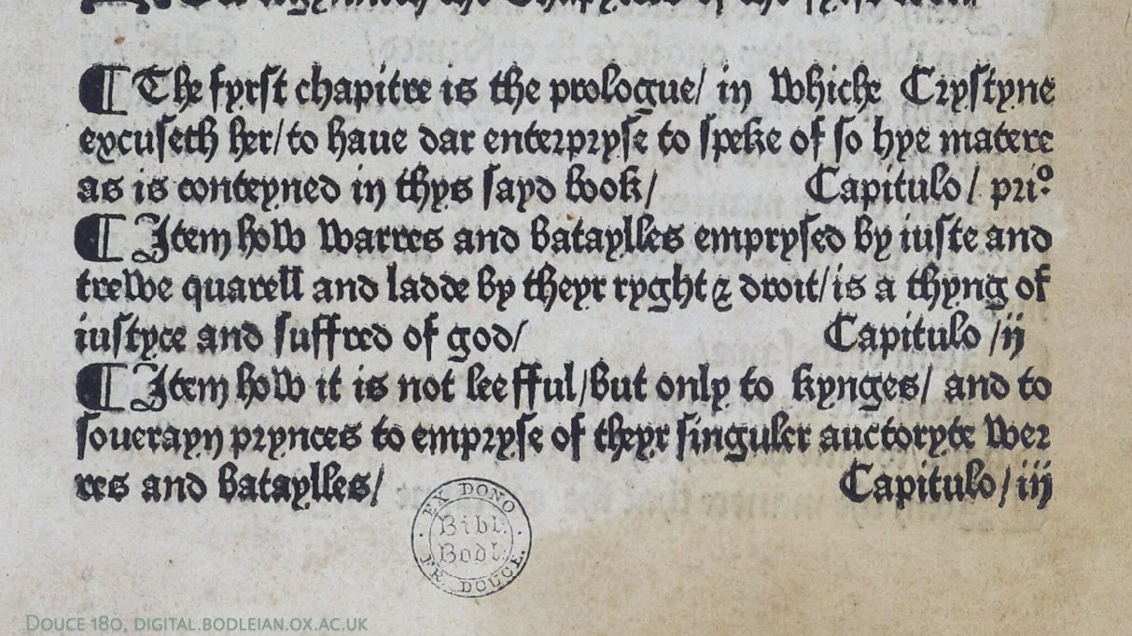
The Book of Deeds of Arms and Chivalry, Christine de Pizan (1410)

Slide 28
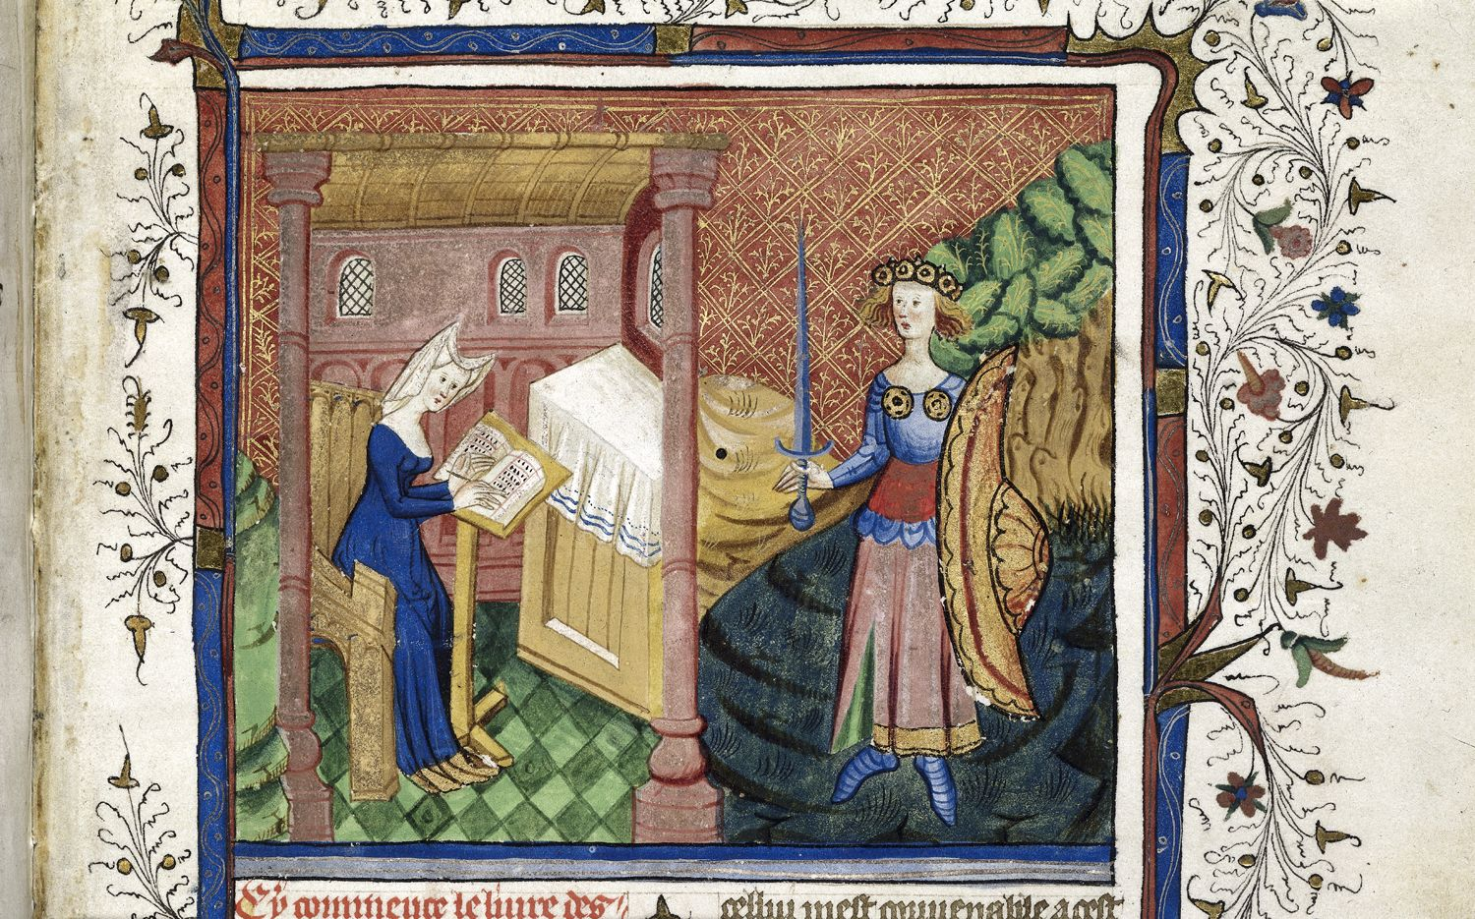
Christine de Pizan and Minerva

Slide 29
Conclusions?
Roles as commanders and generals
Adoption of male dress, names, pronouns
“overcome their sex”
Gender-specific combat strategies
Challenges of interpreting evidence

Slide 30
“Warfare is the one human activity from which women, with the most insignificant exceptions, have always and everywhere stood apart. Women look to men to protect them from danger…women, however, do not fight. They rarely fight among themselves and they never, in any military sense, fight men. If warfare is as old as history and as universal as mankind, we must not enter the supremely important limitation that it is an entirely masculine activity.”
John Keegan, A History of Warfare (1993)

